Slide 1
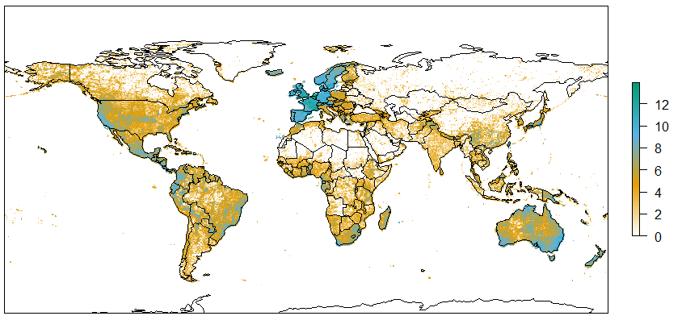
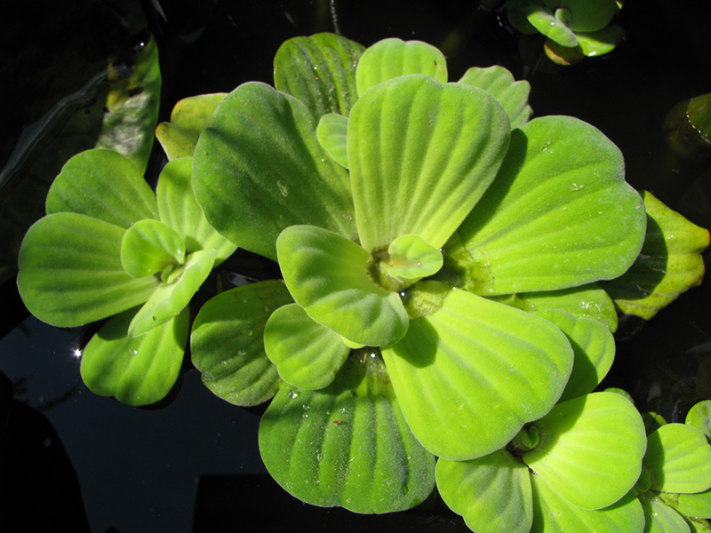
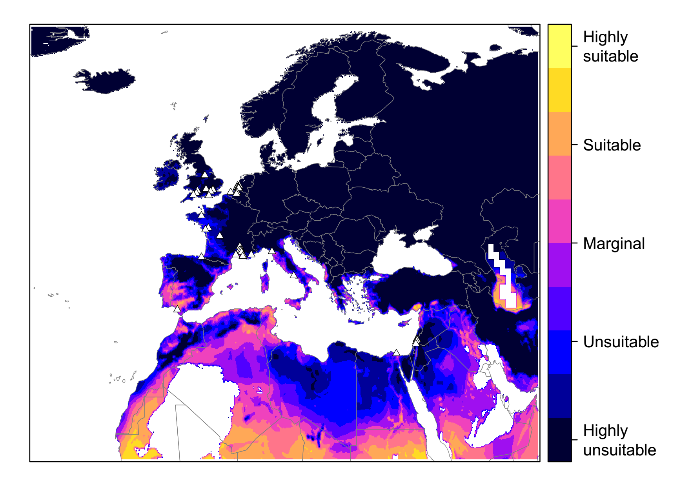
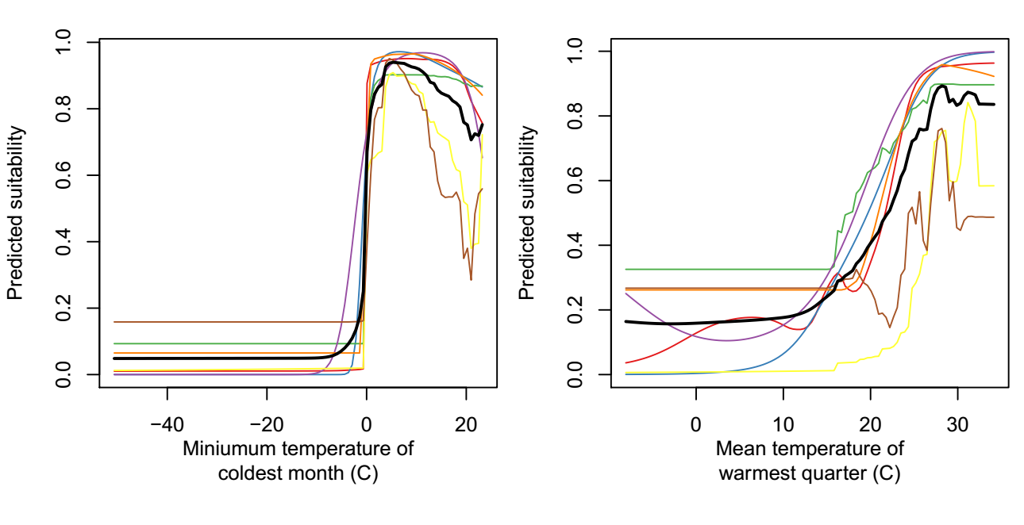
Species distribution models for priority invasive plants
Daniel Chapman¹, Oliver Pescott¹, Helen Roy¹, Robert Tanner²
¹Centre for Ecology & Hydrology, UK
²European and Mediterranean Plant Protection Organization, France
In an EU LIFE Project*, Pest Risk Analysis will be performed for 37 priority non-native plant species, currently absent or rare in Europe but potentially harmful.
These risk assessments need estimates of where the species can establish.
Species Distribution Models will be used to project their potentially-invaded distributions.
Challenges for Species Distribution Models of invasive species:
Non-equilibrium distributions
Niche differences between native and invaded ranges
Spatial variation in recording effort
Casual records in the invaded range
Need a simple and consistent modelling methodology.
‘Presence-background’ modelling approach
1. Input data:
Global species presences (GBIF www.gbif.org & other sources)
Casual records removed in consultation with species experts
Climate and other GIS layers
2. Randomly sample ‘pseudo-absences’:
Sampling region:
Native continent (enough time to disperse)
Buffer around non-native occurrences (assumed propagule pressure for invasion)
A priori unsuitable climate (dispersal constraints are irrelevant)
Sampling weights:
Recording effort (GBIF Tracheophyta record density)
‘Recording effort’ (ln+1 transformed)
3. Model projection:
Fitted 10 modelling algorithms
These contrast the climate of presences vs pseudo-absences
Made ensemble projection of suitability, averaging the different algorithms’ output
Example results: Pistia stratiotes
Native in South America
Many casual presences in Europe and North America
A priori unsuitable if too cold (warmest quarter < 10 °C or coldest month < 0 °C) or dry (wettest quarter < 5 mm and no waterbodies)
Modelled potential suitability for invasion
Example model response functions
(black = ensemble model average)
Suitability
Suitability
Minimum temperature of coldest month (°C)
Mean temperature of warmest quarter (°C)
* EU LIFE Project: Mitigating the threat of invasive alien plants in the EU through pest risk analysis to support the EU Regulation 1143/2014
Thanks to members of the EPPO Expert Working groups, who performed the full PRAs and guided model development.
Contact: Daniel Chapman dcha@ceh.ac.uk

