Slide 1
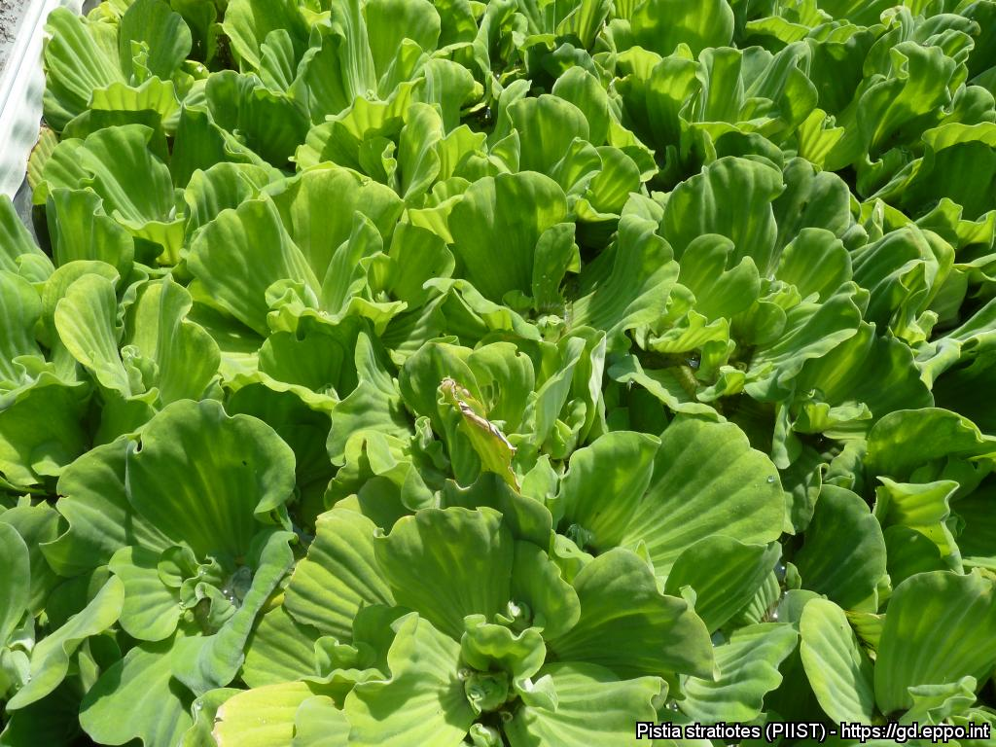
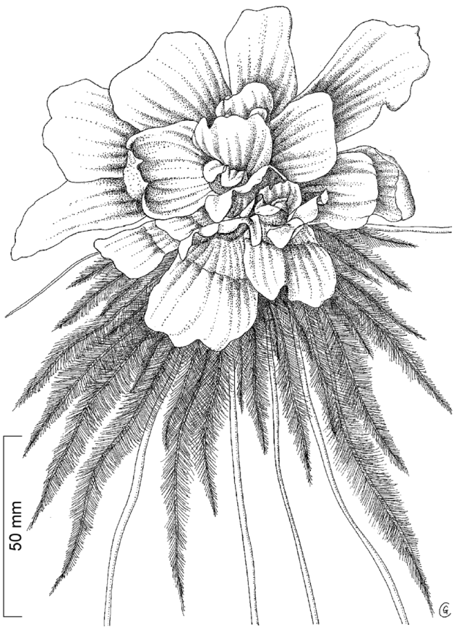
BE AWARE!
Pistia stratiotes
A threat to waterways in the EPPO region
How to recognize it? Can you help us?
Pistia stratiotes is a free floating plant with a rosette of obovate to spatulate, short haired leaves (up to 35 cm in European forms). The upper sides of the leaves are light-green, while the undersides are almost white. The floating plants have a large feathery root systems which hangs freely in the water. The solitary inflorescence is axillary and inconspicuous, with short peduncles in the center of the rosette. The spadix, with a single pistillate flower and several staminate flowers enclosed in a whitish spathe, is pale green, hairy outside and glabrous inside.
Because Pistia stratiotes can seriously impact the habitats it invades, including native plant species, associated insects and important ecosystem services, it is important to report any sightings to plant protection authorities. Early detection will allow a rapid implementation of appropriate measures against Pistia stratiotes.
If you see Pistia stratiotes:
Check the identification of the species with other aquatic native plants.
Whenever possible, take a picture of the plant, record exact location, date and habitat where it was observed.
Contact us.
Contact us
Image: Anne-Sophie Roy, EPPO Global Database
Your contact details
Your institution name
Logo
This leaflet has been prepared within the LIFE funded project LIFE15 PRE FR 001 in collaboration with the NERC Centre for Ecology and Hydrology
Prepared in collaboration with EPPO – www.eppo.int

Slide 2
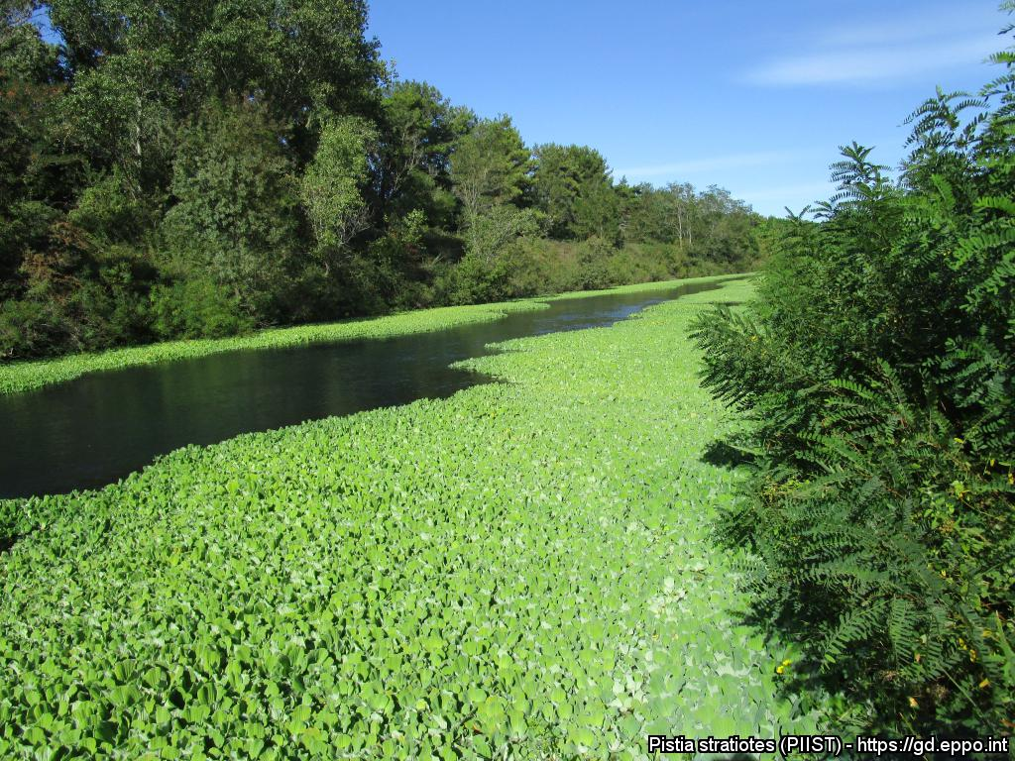
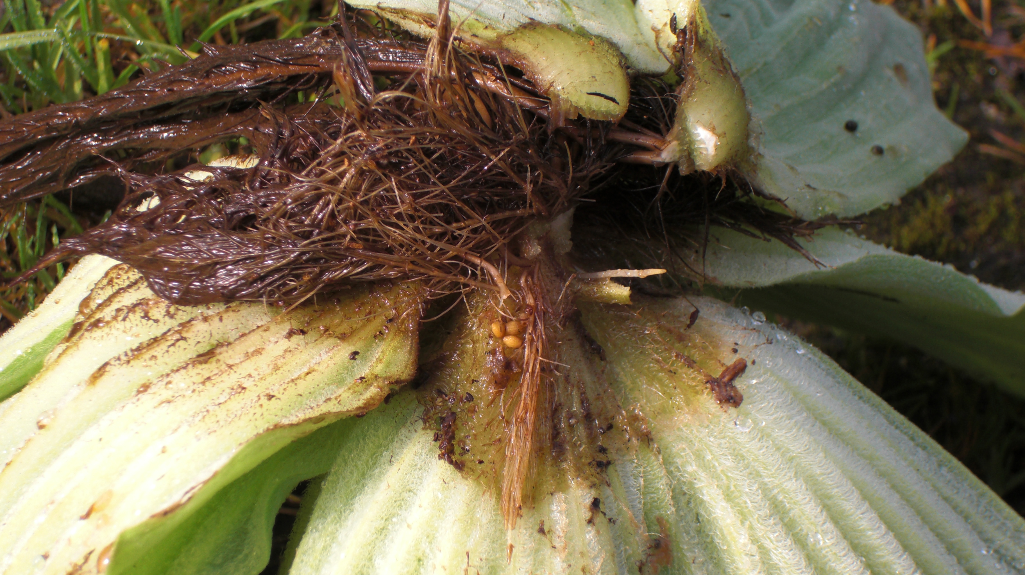
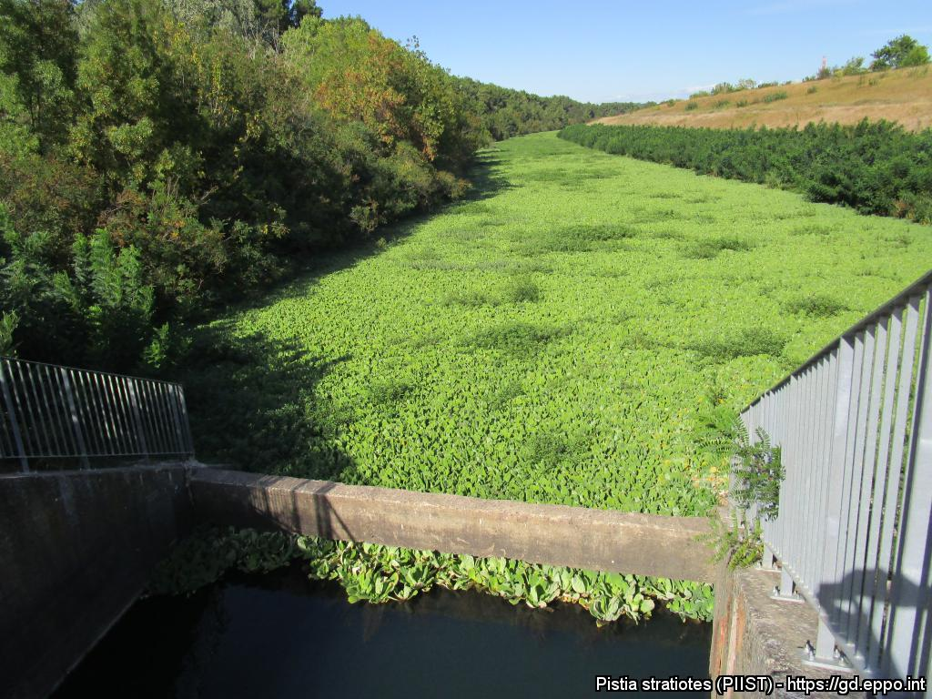
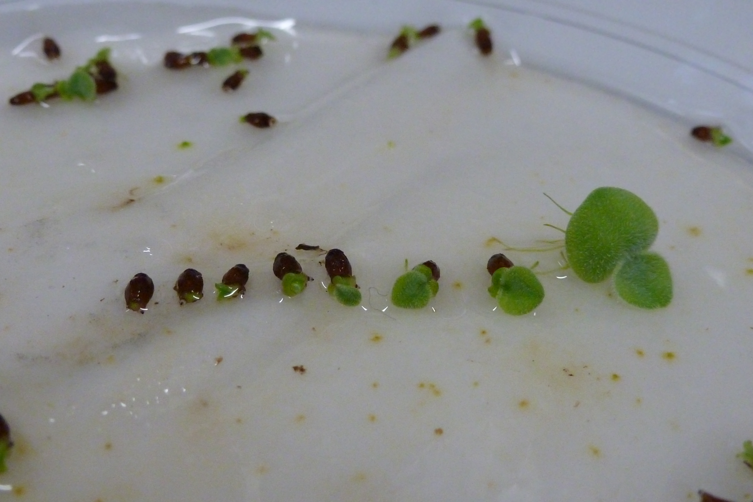
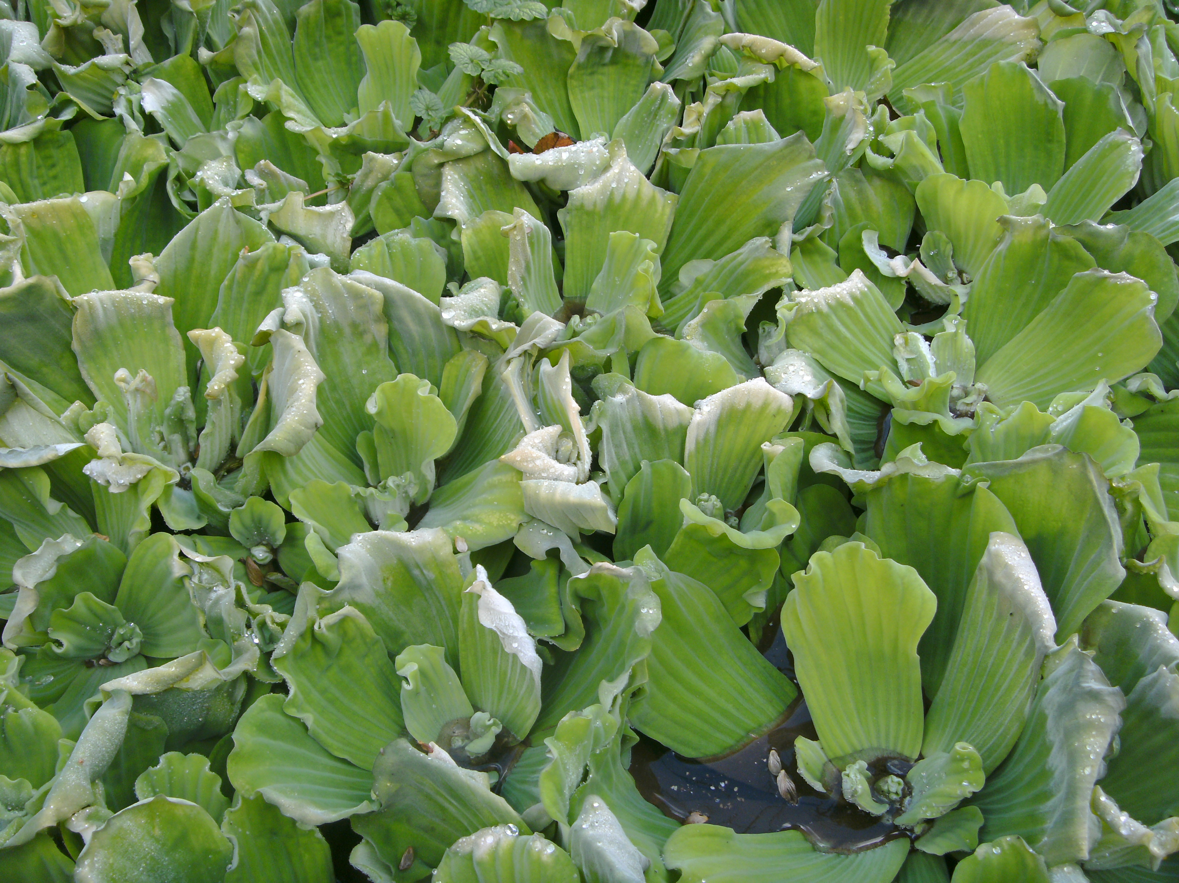
What is Pistia stratiotes? What is the problem? Where is it found?
Dense mats of P. stratiotes can block sunlight, reducing primary production, decreasing water turbidity and outcompete native plant species. Furthermore, the water shaded by P. stratiotes shows decreased levels of oxygen and increased levels of nitrate, ammonium and phosphorus. As a result of the altered habitat, submerged vegetation has been shown to decrease under dense mats along the river Erft in western Germany. Pistia stratiotes mats clog waterways and limit the recreational use of water bodies, reduce the efficiency of irrigation and drainage systems and increase water loss due to evapotranspiration.
Pistia stratiotes forms dense mats at the surface of the water. Pistia stratiotes grows in aquatic habitats such as lakes, canals, reservoirs and slow moving rivers. The species can survive drying, and can reinfest ephemeral waters which are subject to seasonal drying, because of seed survival and germination.
Image: Jean-Philippe Reygrobellet, EPPO Global Database
Pistia stratiotes is an aquatic water plant, native to South America and is an EPPO A2 pest, recommended for regulation as a quarantine pest. In the EPPO region, Pistia stratiotes is recorded from Austria, Belgium, Czech Republic, France, Germany, Hungary, Israel, Italy, Morocco, Netherlands, Norway, Portugal, Romania, Russia, Slovenia, Spain, United Kingdom.
As Pistia stratiotes is considered to be a serious threat to waterways, its appearance in new areas should be reported immediately to us.
Image: Jean-Philippe Reygrobellet, EPPO Global Database
Images: Andreas Hussner, EPPO Global Database
Image: Andreas Hussner, EPPO Global Database

Slide 3
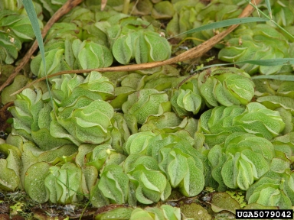
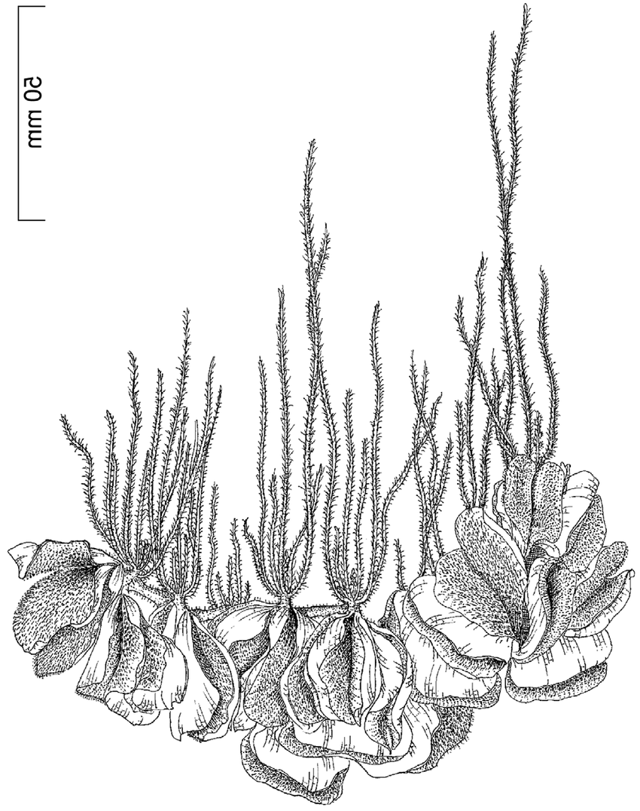
BE AWARE!
Salvinia molesta
A threat to waterways in the EPPO region
How to recognize it? Can you help us?
Salvinia molesta is a free-floating fern. The three growth stages (primary, secondary and tertiary), may make identification of the species difficult. The small-leafed primary stage is typical of plants invading open water. The secondary form is slightly larger with leaves slightly folded, and the tertiary stage is typical of mature stands with larger deeply folded and densely packed leaves. The species’ fronds are positioned in whorls of three along a rhizome, with individual plants growing up to 30 cm.
Because Salvinia molesta has the potential to seriously impact the habitats it invades, including native plant species, associated insects and important ecosystem services, it is important to report any sightings to plant protection authorities. Early detection will allow a rapid implementation of appropriate measures against Salvinia molesta .
If you see Salvinia molesta :
Check the identification of the species with other aquatic native plants.
Whenever possible, take a picture of the plant, record exact location, date and habitat where it was observed.
Contact us.
Contact us
Image: Robert Vidéki, Doronicum Kft., Bugwood.org
Your contact details
Your institution name
Logo
This leaflet has been prepared within the LIFE funded project LIFE15 PRE FR 001 in collaboration with the NERC Centre for Ecology and Hydrology
Prepared in collaboration with EPPO – www.eppo.int

Slide 4
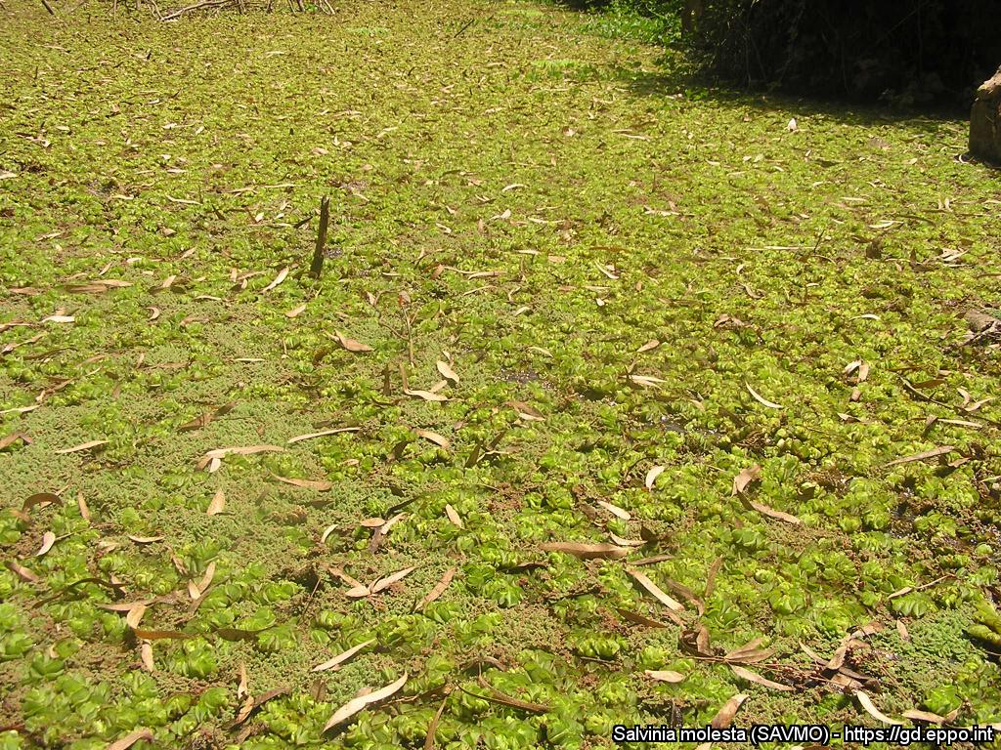
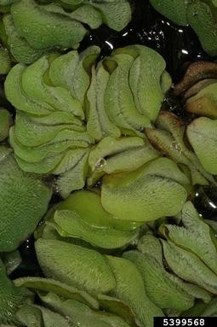
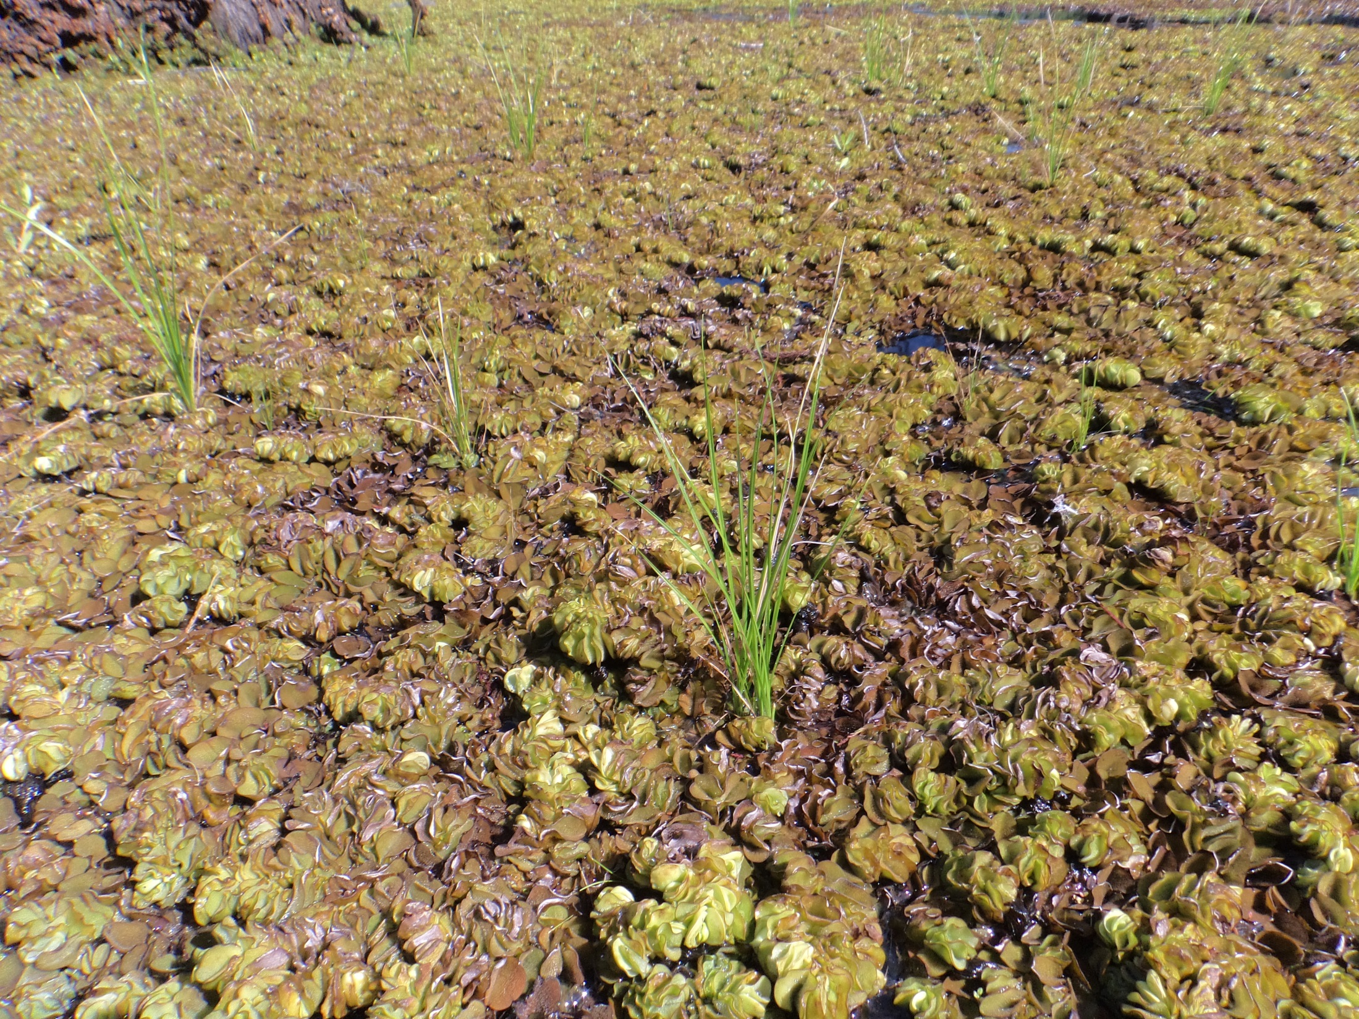
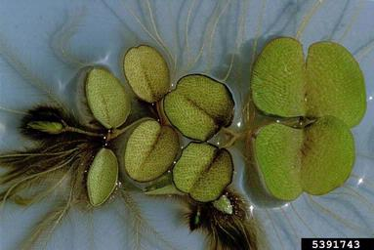
What is Salvinia molesta? What is the problem? Where is it found?
Mats of S. molesta can cause similar problems to those caused by excessive growth of other floating plants; for example, they can reduce access to the water for recreation; interfere with various engineering structures such as weirs, floodgates or locks; block drains and cause flooding; stop livestock reaching water; prevent photosynthesis in the water below the mat; degrade water; have negative impacts on native animals and plants more generally by significantly altering aquatic ecosystems; reduce the aesthetic appeal of water bodies; and favour the spread of certain diseases spread by mosquitos and snails.
Salvinia molesta is most often found in stagnant or slow-flowing waters such as lakes, slow-flowing rivers or streams, wetlands, rice paddies, irrigation channels, ditches, ponds and canals.
In the EPPO region, S. molesta has been found in Austria, Belgium, France (Corsica), Germany, Italy, Israel, the Netherlands and Portugal, but it is not clear if reports represent established populations.
Image: Jean-Marc Dufour-Dror, EPPO Global Database
Salvinia molesta is a perennial floating aquatic fern, native to South America and is an EPPO A2 pest, recommended for regulation as a quarantine pest.
As Salvinia molesta is considered to be a serious threat to waterways, its appearance in new areas should be reported immediately to us.
Image: Barry Rice, sarracenia.com, Bugwood.org
Image: Robert Vidéki, Doronicum Kft., Bugwood.org
Image: Michel Netherland, US Army Engineer Research and Development Center

Slide 5
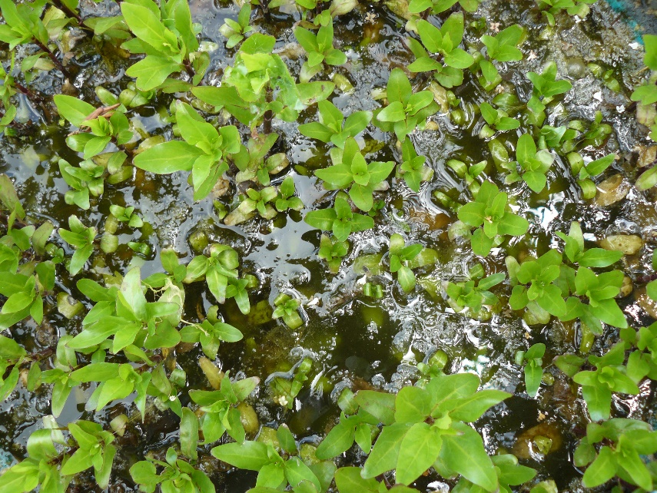
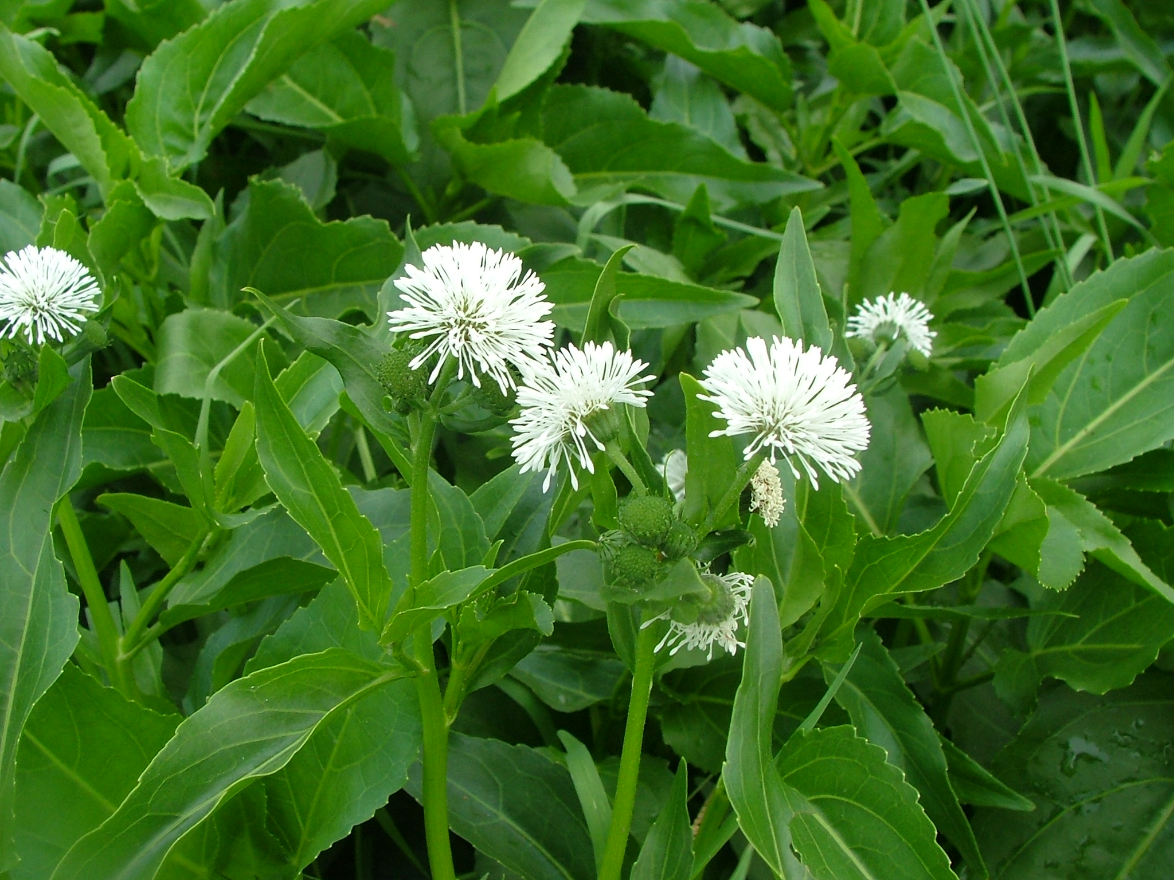
BE AWARE!
Gymnocoronis spilanthoides
A threat to waterways in the EPPO region
How to recognize it? Can you help us?
Gymnocoronis spilanthoides is an emergent perennial herb, either forming upright bushes up to 1.5 m tall, tangled sprawling floating mats or occasionally fully submerged in shallow water. Leaves lanceolate or ovate, opposite, 50 to 200 mm long 25 to 75 mm wide, serrate with wavy margins, veins pinnate. Submerged foliage usually entire but wavy margins, petiolate, 10 to 70 mm long. As a white flowered aquatic species, G. spilanthoides could potentially be misidentified for Alternanthera philoxeroides, though for this species the flowers are more compact, the petals are shorter in length and the leaves are shorter.
Because G. spilanthoides has the potential to seriously impact the habitats it invades, including native plant species, associated insects and important ecosystem services, it is important to report any sightings to plant protection authorities. Early detection will allow a rapid implementation of appropriate measures against G. spilanthoides .
If you see G. spilanthoides:
Check the identification of the species with other aquatic native plants.
Whenever possible, take a picture of the plant, record exact location, date and habitat where it was observed.
Contact us.
Contact us
Images: Paul Champion, EPPO Global Database
Your contact details
Your institution name
Logo
Images: Paul Champion, EPPO Global Database
This leaflet has been prepared within the LIFE funded project LIFE15 PRE FR 001 in collaboration with the NERC Centre for Ecology and Hydrology
Prepared in collaboration with EPPO – www.eppo.int

Slide 6
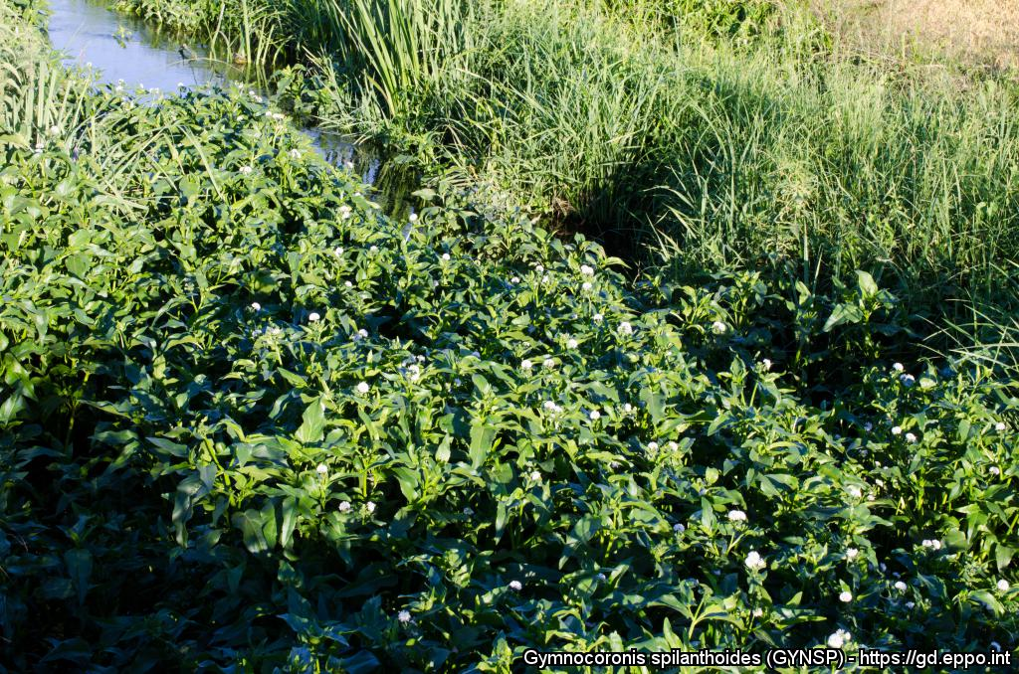
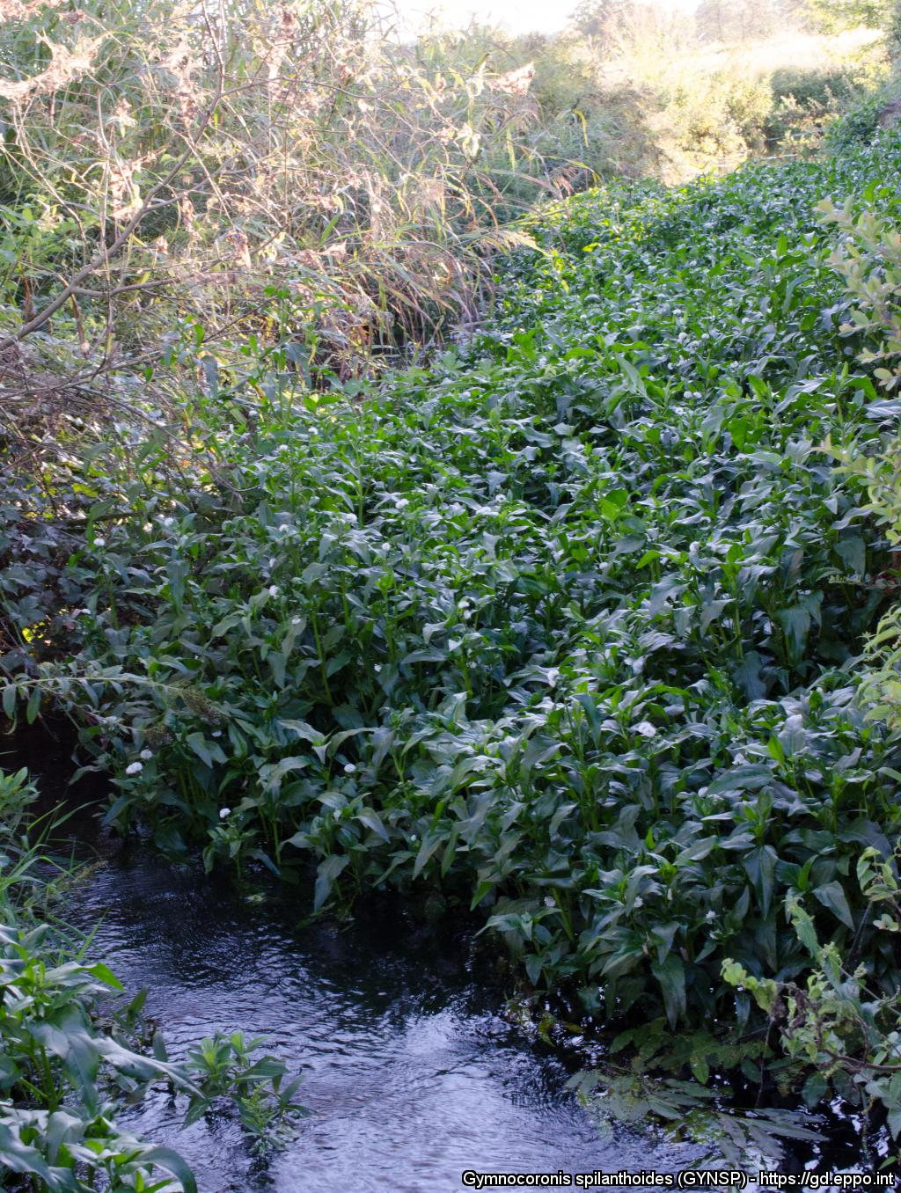
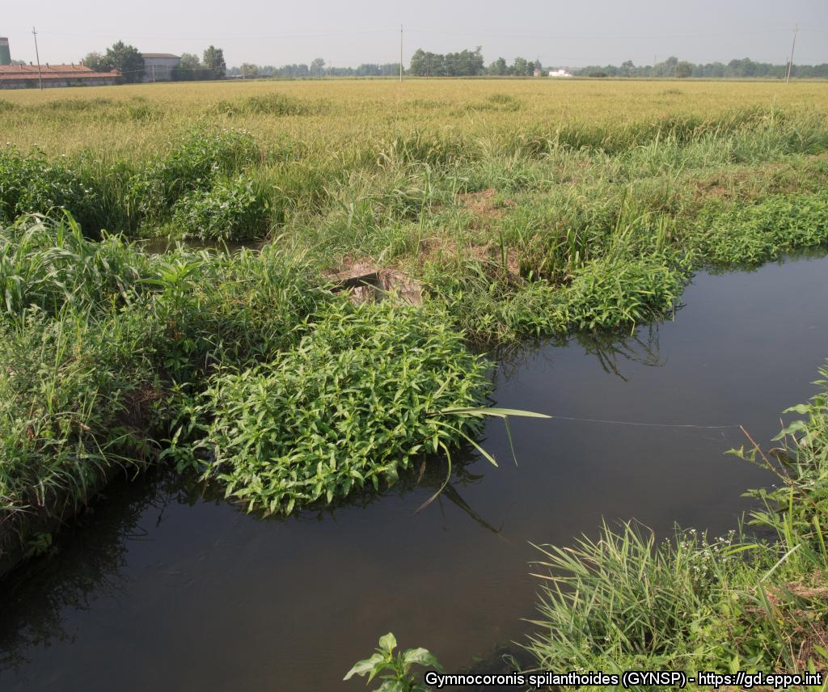
What is G. spilanthoides? What is the problem? Where is it found?
Gymnocoronis spilanthoides is an aquatic water plant, native to South America and is an EPPO A2 pest, recommended for regulation as a quarantine pest.
As Gymnocoronis spilanthoides is considered to be a serious threat to waterways, its appearance in new areas should be reported immediately to us.
Plants for planting is considered the main pathway for entry into the EPPO region. From this pathway, individual plants can be transferred to suitable habitats through either intentional introductions into the environment or unintentionally through the disposal of aquarium material. Although at an early stage of establishment in the EPPO region, G. spilanthoides, like other aquatic invasive plants can threaten biodiversity and causes other environmental damage.
In the EPPO region, G. spilanthoides is recorded from Hungary and Italy. Within its introduced range, G. spilanthoides grows in wetlands, particularly degraded waterways forming marginal clumps on the edge of slow flowing or still water bodies, also forming dense sprawling floating mats in rivers (including tidally influenced areas) and reservoirs, irrigation channels, ponds, lakes, canals and ditches. It also grows in marshes and swamps, especially where nutrient enriched. G. spilanthoides established but did not persist in a rice field in Italy.
Images: Claudio Ballerini, EPPO Global Database
Images: Claudio Ballerini, EPPO Global Database
Images: Claudio Ballerini, EPPO Global Database

Slide 7
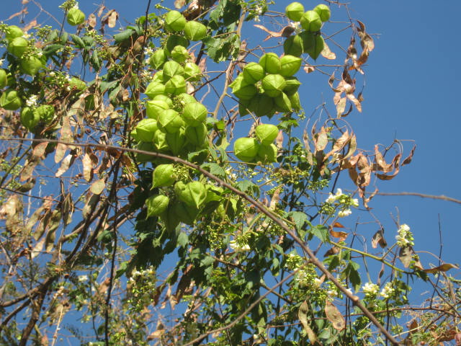
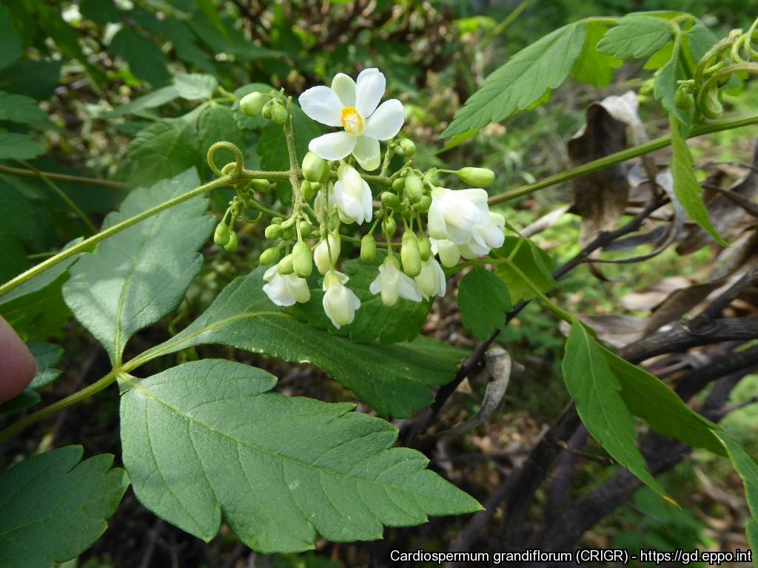
BE AWARE!
Cardiospermum grandiflorum
A threat to the EPPO region
How to recognize it? Can you help us?
Cardiospermum grandiflorum is a large, semi-woody annual or perennial often draping over other vegetation. While the fruit of C. grandiflorum can be variable (size and shape), their distinct shape and coverage by hairs make the species easily recognizable and distinguishable from closely related taxa such as C. halicacabum and C. corindum. Cardiospermum grandiflorum has hairy ribbed stems that are reddish-green in colour covered in bristly hairs. Leaves are compound and up to 16 cm long and are dark green and heavily serrated. The species' flowers have four petals that are white with a yellow lip.
Because Cardiospermum grandiflorum has the potential to impact the habitats it invades, including native plant species and important ecosystem services, it is important to report any sightings to plant protection authorities. Early detection will allow a rapid implementation of appropriate measures against Cardiospermum grandiflorum.
If you see Cardiospermum grandiflorum:
Check the identification of the species with other vine like species.
Whenever possible, take a picture of the plant, record exact location, date and habitat where it was observed.
Contact us.
Contact us
Image: Johannes Le Roux, EPPO Global Database
Your contact details
Your institution name
Logo
Image: Iñigo Sánchez, EPPO Global Database
This leaflet has been prepared within the LIFE funded project LIFE15 PRE FR 001 in collaboration with the NERC Centre for Ecology and Hydrology
Prepared in collaboration with EPPO – www.eppo.int

Slide 8
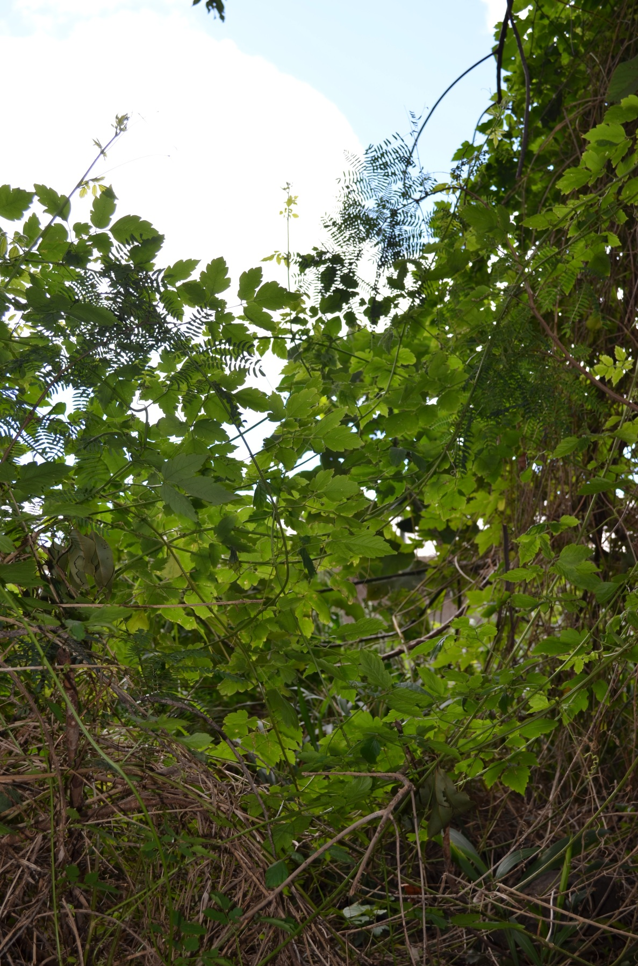
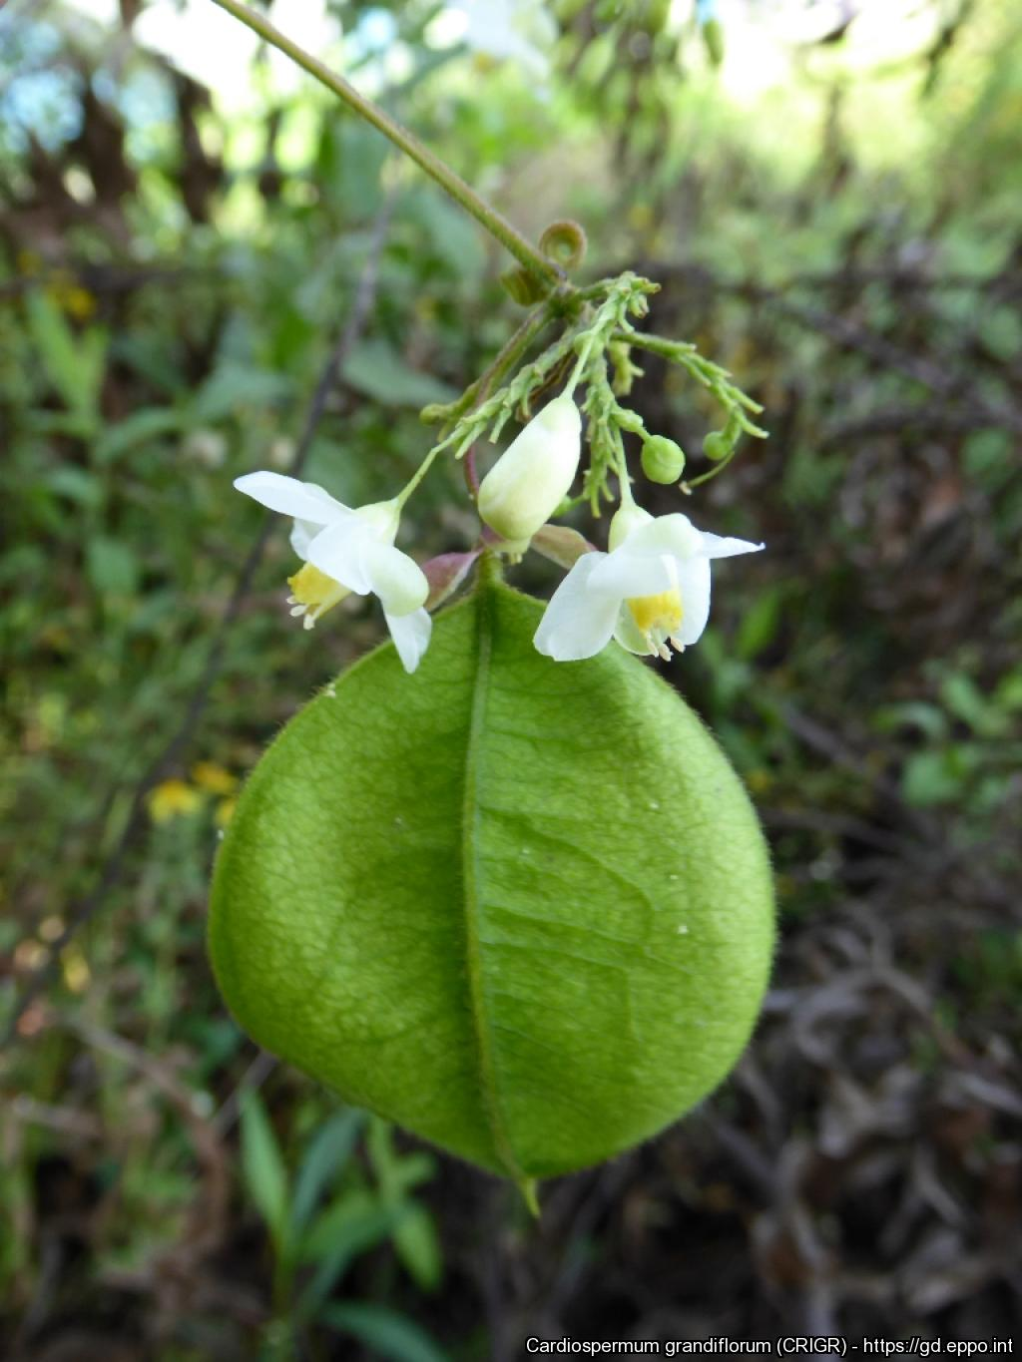
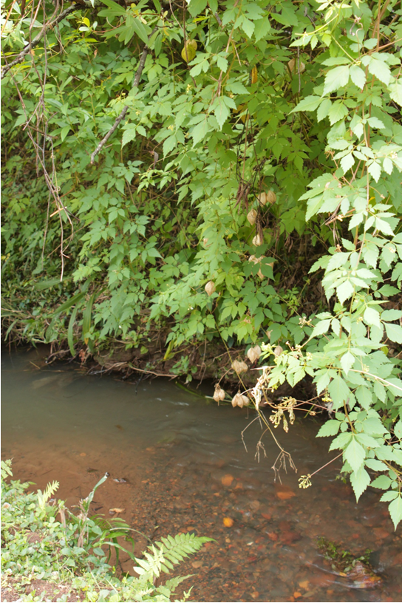
What is C. grandiflorum? What is the problem? Where is it found?
Cardiospermum grandiflorum is a annual or perennial vine-like climber native to the Americas and is an EPPO A2 pest, recommended for regulation as a quarantine pest.
As Cardiospermum grandiflorum is considered to be a threat to native biodiversity, its appearance in new areas should be reported immediately to us.
Plants for planting is considered the main pathway for entry into the EPPO region. In its invasive range C. grandiflorum typically forms dense draping carpets/mats, smothering large areas of underlying vegetation. In Malta, there is evidence of impacts on biodiversity as the species has formed extensive invasive populations. The invaded area in Malta may present unique micro-climatic conditions for the species due to it being a steep-sided dry valley.
In the EPPO region, C. grandiflorum is recorded from France (only in Landes and Alpes-Maritimes departments), Italy (mainland and the Island of Sicily), Malta, Portugal (only in Madeira Island), Spain (only in Canary Islands: Gran Canaria, Tenerife, La Gomera, La Palma).
C. grandiflorum prefers open habitats though it may grow well in forest edges and thrives in well-drained soil types
Image: Iñigo Sánchez, EPPO Global Database
Image: Johannes Le Roux, EPPO Global Database
Image: Johannes Le Roux, EPPO Global Database

Slide 9
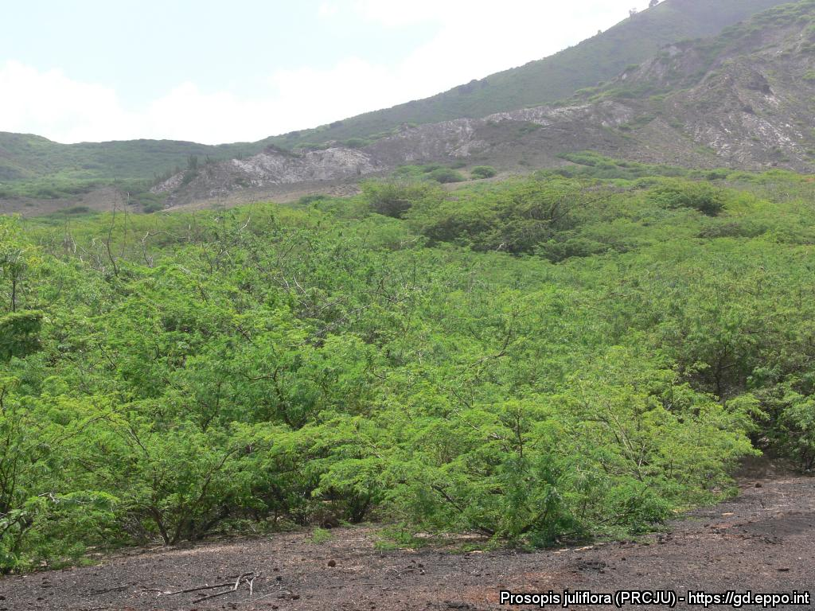
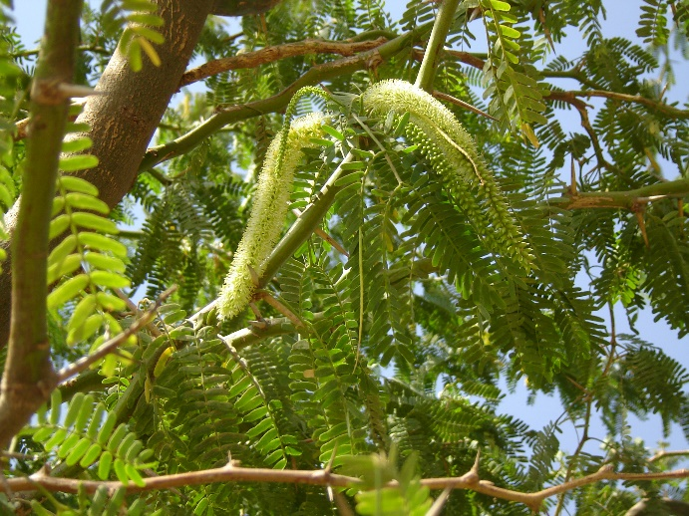
BE AWARE!
Prosopis juliflora
A threat to the EPPO region
How to recognize it? Can you help us?
P. juliflora is a tree 3-12 m tall, sometimes shrubby with spreading branches; wood hard; branches cylindrical, green, more or less round- or flat-topped, somewhat spiny with persistent, green (sometimes glaucous or greyish, not reddish) foliage, glabrous or somewhat pubescent or ciliate on the leaflets; spines axillary, uninodal, divergent, paired, or solitary and paired on the same branches, sometimes absent, not on all branchlets, measuring 0.5-5.0 cm long, being largest on strong, basal shoots. Leaves bipinnate, glabrous or pubescent, 1-3 pairs of pinnae, rarely 4 pairs; petiole plus rachis (when present) 0.5-7.5 cm long; pinnae 3-11 cm long; leaflets 6 to 29, generally 11 to 15 pairs per pinna, elliptic-oblong, glabrous or ciliate, rarely pubescent, approximate on the rachis or distant a little more than their own width, herbaceous to submembranous.
Because Prosopis juliflora has the potential to impact the habitats it invades, including native plant species and important ecosystem services, it is important to report any sightings to plant protection authorities. Early detection will allow a rapid implementation of appropriate measures against Prosopis juliflora .
If you see Prosopis juliflora:
Check the identification of the species with other woody-like species.
Whenever possible, take a picture of the plant, record exact location, date and habitat where it was observed.
Contact us.
Contact us
Image: Norbert Maczey, EPPO Global Database
Your contact details
Your institution name
Logo
Image: Nick Pasiecznik, EPPO Global Database
This leaflet has been prepared within the LIFE funded project LIFE15 PRE FR 001 in collaboration with the NERC Centre for Ecology and Hydrology
Prepared in collaboration with EPPO – www.eppo.int

Slide 10
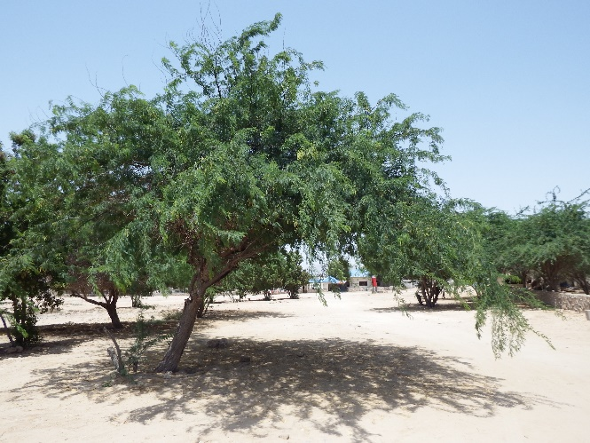
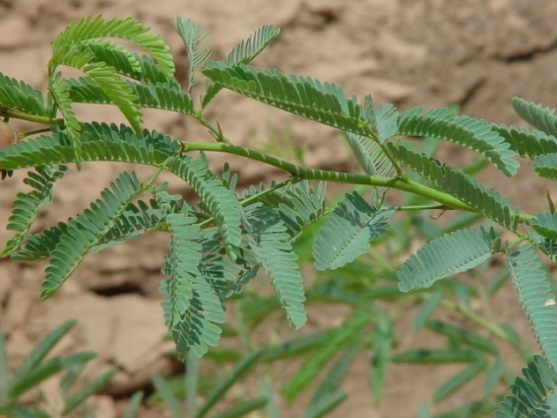
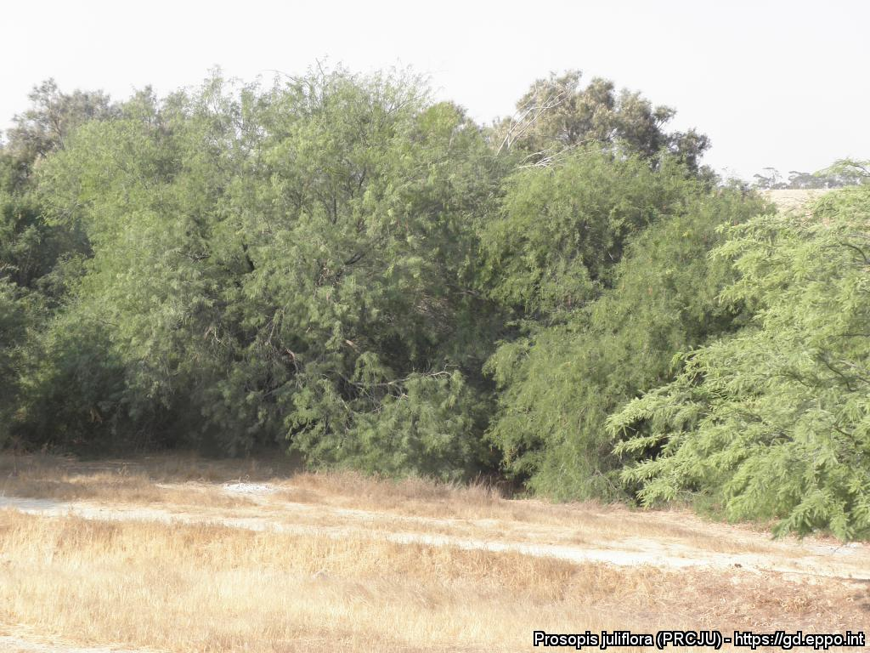
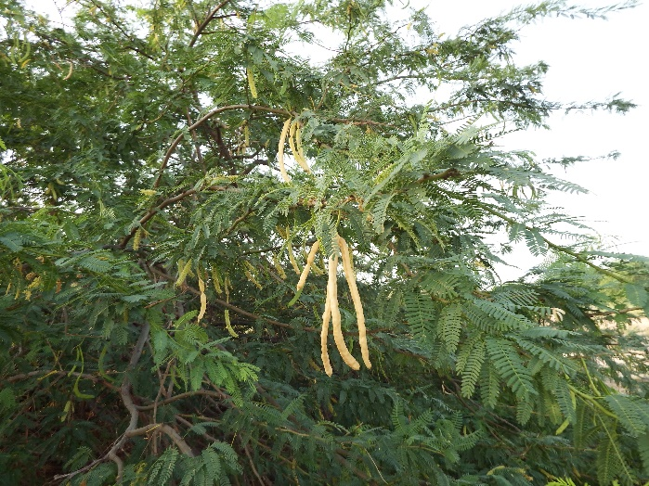
What is Prosopis juliflora? What is the problem? Where is it found?
Prosopis juliflora is an evergreen, broadleaved perennial woody shrub or tree and is native to the Americas.
A major limitation to the distribution of P. juliflora is mean minimum temperature and the frequency and duration of frosts. Light frosts cause dieback of the branches, harder frosts may cause complete stem mortality, and more severe or longer-lasting frosts can cause complete death of the plant.
Plants for planting is a potential pathway for the entry of P. juliflora into the EPPO region. Seeds are widely available via numerous online global mail order suppliers.
The two reported introductions into the EPPO region, as with most global introductions, have been as seed for reforestation. P. juliflora is a very aggressive invader with the potential to outcompete and replace native vegetation.
Prosopis species have large impacts upon water resources, nutrient cycling, successional process, and soil conservation.
P. juliflora has been shown to be a major cause of allergenic disease and thus planting in urban areas is not recommended.
In the EPPO region the species is reported from Algeria, Spain (Mainland and Gran Canaria), Israel, Jordan, Morocco, Tunisia.
In the native and introduced ranges, P. juliflora is found in a number of different habitats including: wasteland, forest, managed and natural grassland, coastal areas (including coastal dunes), wetlands, abandoned field and urban areas (for example roadside).
Image: Nick Pasiecznik, EPPO Global Database
Image: Nick Pasiecznik, EPPO Global Database
Images: Nick Pasiecznik, EPPO Global Database

Slide 11
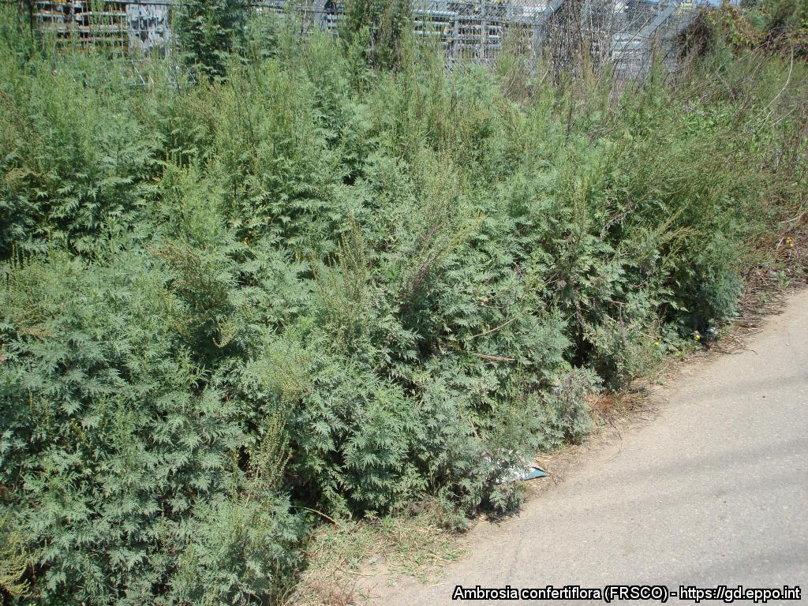
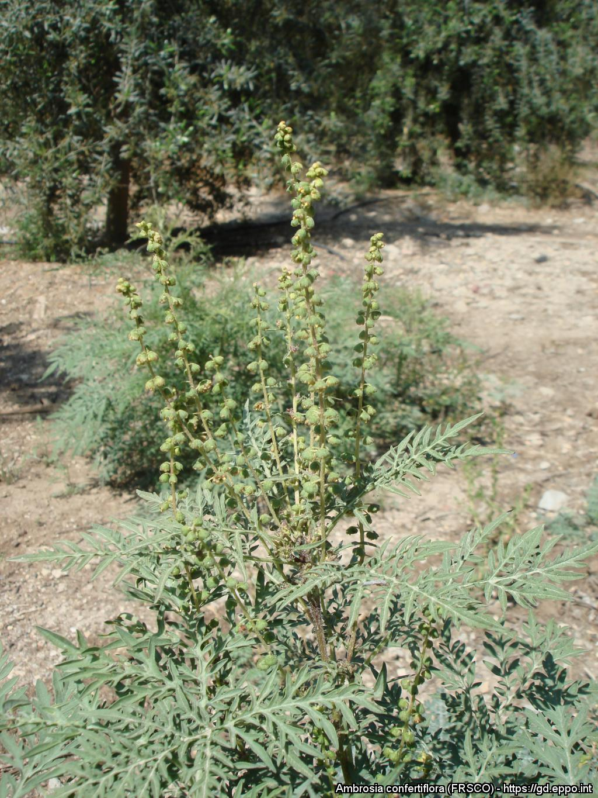
BE AWARE!
Ambrosia confertiflora
A threat to the EPPO region
How to recognize it? Can you help us?
The leaves have short petioles and are bipinnate, divided into long lobes; their margins have sparse short hairs. The leaves are opposite at the base of the stem and alternate on the upper part of the plant. The leaves release a characteristic strong smell that may help to identify the plant. Ambrosia confertiflora is monoecious and has male and female yellow or greenish flowers. The male flowers are numerous and small (diameter about 1 cm) and are borne on erect clusters. The female flowers lack petals and are concentrated in the leaf axils in a cup-shaped involucre.
Because Ambrosia confertiflora has the potential to impact the habitats it invades, including native plant species and important ecosystem services, it is important to report any sightings to plant protection authorities. Early detection will allow a rapid implementation of appropriate measures against Ambrosia confertiflora.
If you see Ambrosia confertiflora:
Check the identification of the species with other similar species.
Whenever possible, take a picture of the plant, record exact location, date and habitat where it was observed.
Contact us.
Contact us
Image: Swen Follak, EPPO Global Database
Your contact details
Your institution name
Logo
Image: Swen Follak, EPPO Global Database
This leaflet has been prepared within the LIFE funded project LIFE15 PRE FR 001 in collaboration with the NERC Centre for Ecology and Hydrology
Prepared in collaboration with EPPO – www.eppo.int

Slide 12
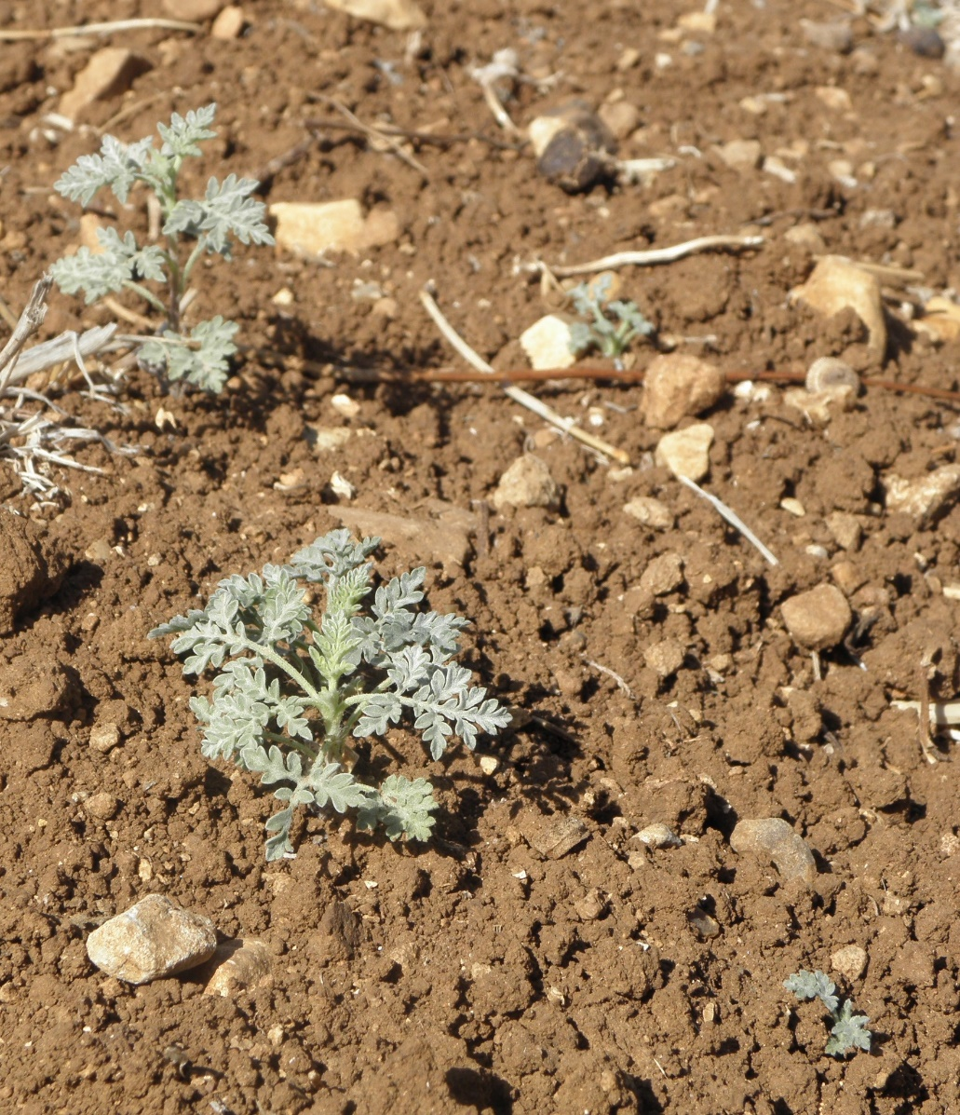
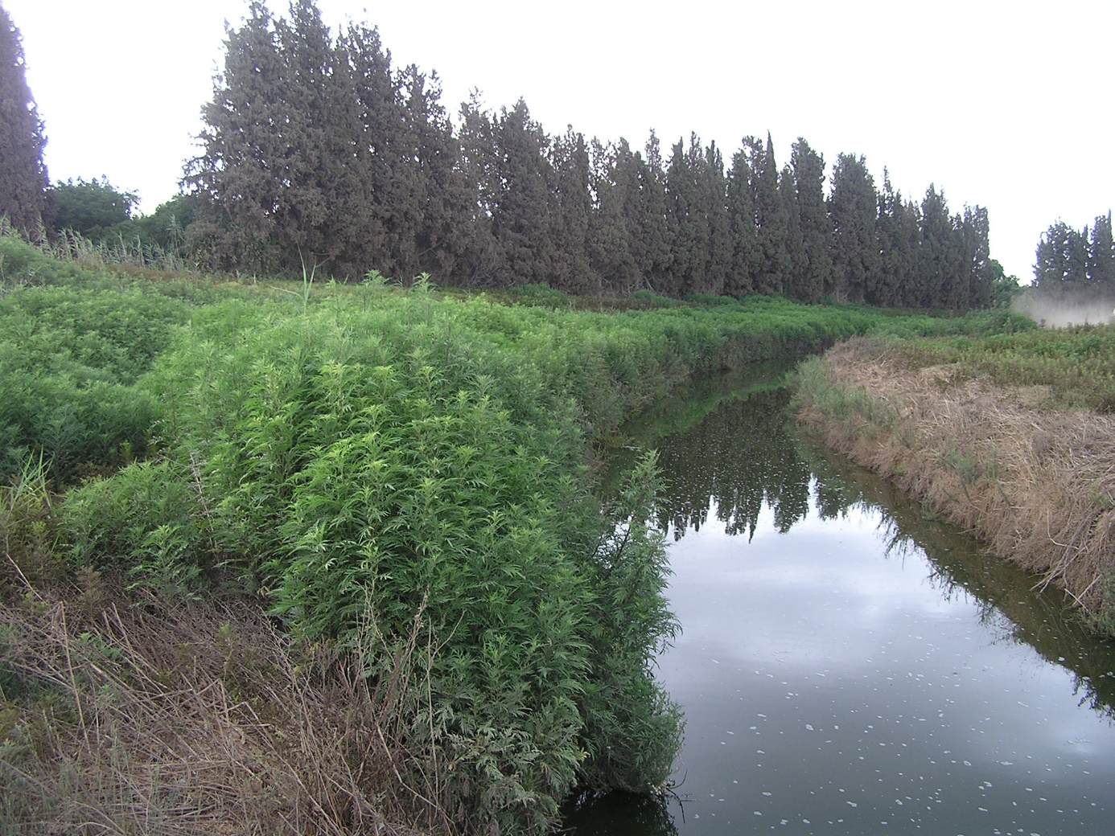
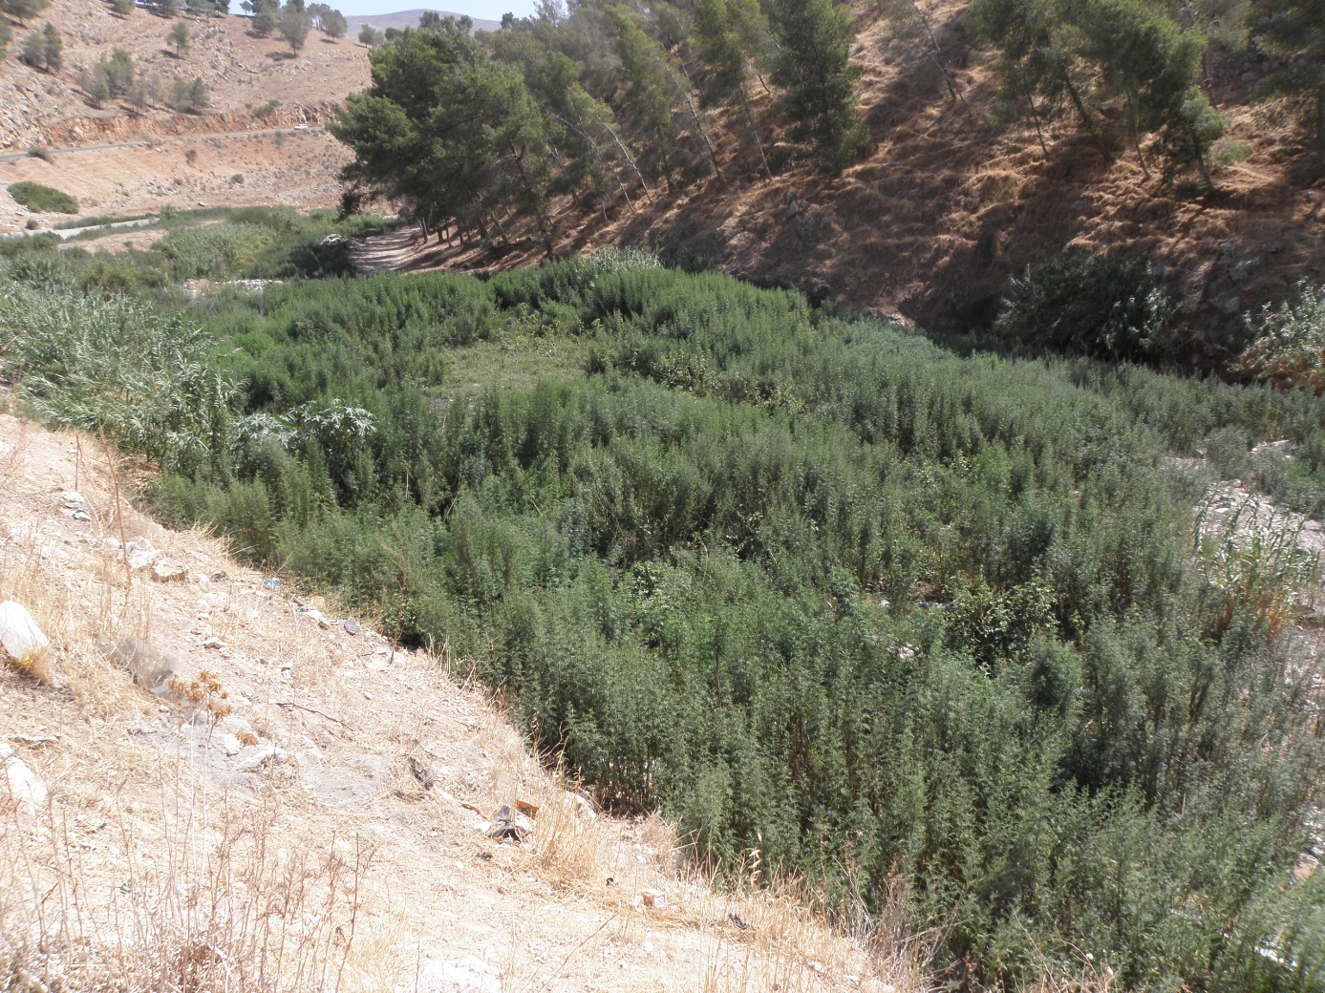
What is A. confertiflora? What is the problem? Where is it found?
Ambrosia confertiflora (EPPO List of invasive alien plants) is an erect perennial herb (Hemicryptophyte) native to North America and non-native to Australia and Israel.
As Ambrosia confertiflora is considered to be a threat to native biodiversity, its appearance in new areas should be reported immediately to us.
There is no clear information on the pathway of entry of A. confertiflora into the EPPO region (Israel). Contamination of livestock from Australia, animal seed mixture and contamination of machinery by seed are all possible pathways. A. confertiflora forms dense stands that can outcompete native plant species. A monoculture can act to suppress understory native plants which results in environmental impacts, in particular in humid habitats, in grasslands and in dry river beds. The plant competes for nutrients and can spread among cultivated fields and mixes with crops which cannot be harvested properly.
The species is absent from Europe.
In Israel, Ambrosia confertiflora occurs in various natural and disturbed habitats, including dry plains and semi-arid valleys, degraded pastures, cultivated orchards, summer field crops (cotton and water melon) avocado and date groves, along roadsides, river-banks, and wadi beds (dry river beds), in wastelands and other disturbed areas.
Image: Swen Follak, EPPO Global Database
Image: Jean-Marc Dufour-Dror, EPPO Global Database
Image: Jean-Marc Dufour-Dror, EPPO Global Database

Slide 13
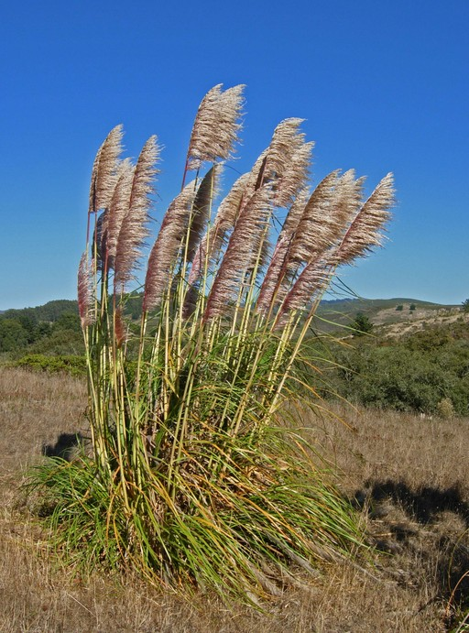
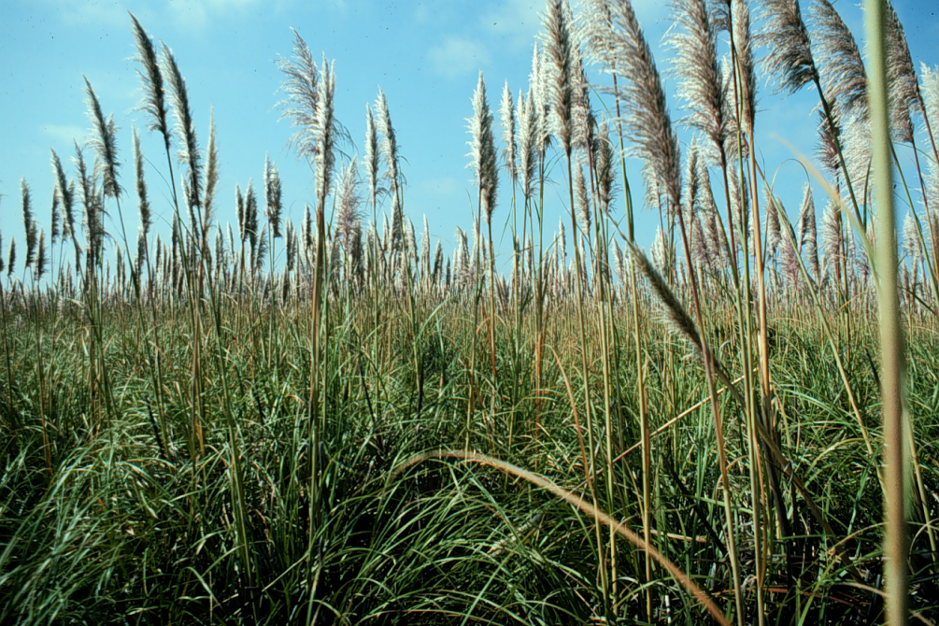
BE AWARE!
Cortaderia jubata
A threat to the EPPO region
How to recognize it? Can you help us?
When inflorescences are present, C. jubata can generally be distinguished from C. selloana by inflorescences that extend well above the foliage and young inflorescences that are violet hued rather than purely white or yellow as they are in C. selloana.
However, individuals of both taxa appear to express a high degree of phenotypic plasticity in these traits. Regional taxonomic treatments have identified a number of other potentially discriminating traits including: leaf blades in C. jubata that are dark green on both sides but blue green above and dark green below in C. selloana.
Because Cortaderia jubata has the potential to impact the habitats it invades, including native plant species and important ecosystem services, it is important to report any sightings to plant protection authorities. Early detection will allow a rapid implementation of appropriate measures against Cortaderia jubata.
If you see Cortaderia jubata:
Check the identification of the species with other grass-like species.
Whenever possible, take a picture of the plant, record exact location, date and habitat where it was observed.
Contact us.
Contact us
©2008 Neal Kramer
Your contact details
Your institution name
Logo
Image: John Lambrinos, EPPO Global Database
This leaflet has been prepared within the LIFE funded project LIFE15 PRE FR 001 in collaboration with the NERC Centre for Ecology and Hydrology
Prepared in collaboration with EPPO – www.eppo.int

Slide 14
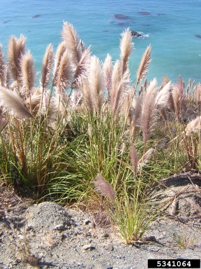
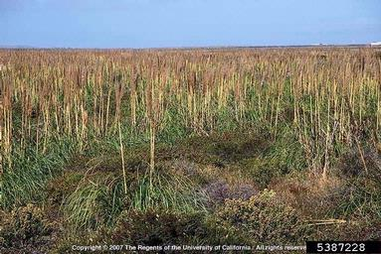
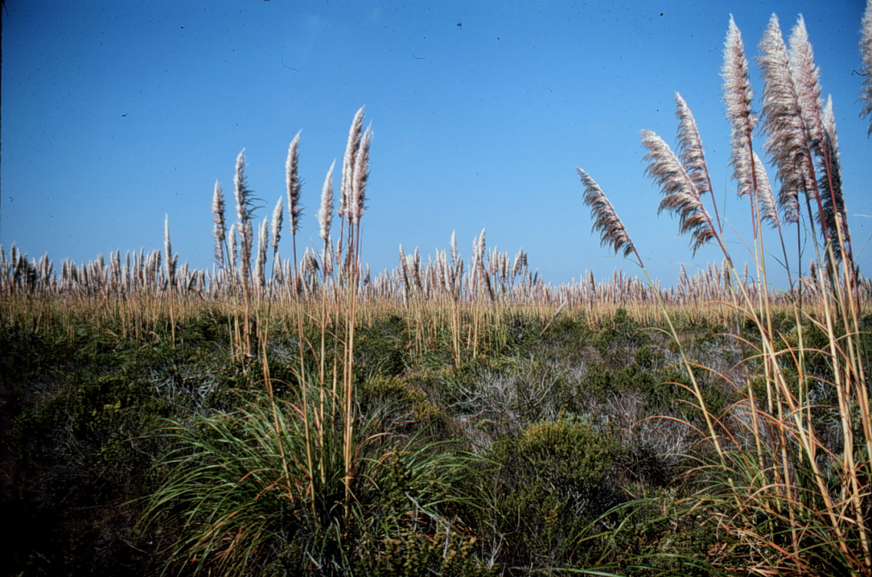
What is C. Jubata? What is the problem? Where is it found?
Cortaderia jubata is tall perennial grass tussock-forming grass species native to South America.
Only female plants of C. jubata are known to occur and this species reproduces from seeds produced from unfertilised female ovules.
C. jubata is extremely fecund, producing over 100 000 seeds from a single inflorescence in one season, with an adult plant having between five and 20 inflorescences
In California the species has been found to be able to outcompete native plants once it has established. This species produces a large amount of above- and belowground biomass that allow it to acquire light, moisture, and nutrients that would be used by other plants . Coastal sand dunes and inland sand hills are the most invaded habitats, and these harbour a number of rare and endangered plant species. Associated with vegetation change is a decrease in arthropod abundance and diversity. Rodents were less common in C. jubata-dominated grasslands, but rabbits more common. In Hawaiʽi, the species has been recorded as developing into dense monotypic stands in mesic to humid areas with the potential to replace or compete with native species.
It is invasive in North America, South Africa, Australia and new Zealand and is currently absent from the natural environment in the EPPO region.
In its current invasive range, it invades a wide range of habitats including disturbed/ruderal areas such as roadsides, logged forests/plantations and is capable of invading areas with intact vegetation. Plants for planting is one pathway for the movement of the species. Cortaderia jubata has been historically planted as an ornamental in France, Ireland and the UK.
C. jubata has a very broad environmental tolerance. However, it establishes best in wet, sandy soil without existing vegetation and has been shown to germinate best in high light, warm (~20º C) and moist conditions.
Image: Mandy Tu, The Nature Conservancy, Bugwood.org
Image: Joseph M. DiTomaso, University of California - Davis, Bugwood.org
Image: John Lambrinos, EPPO Global Database

Slide 15
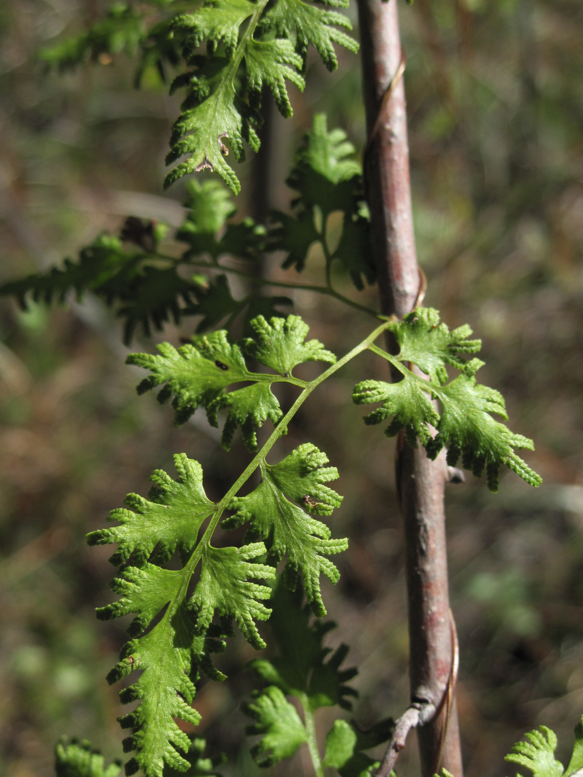
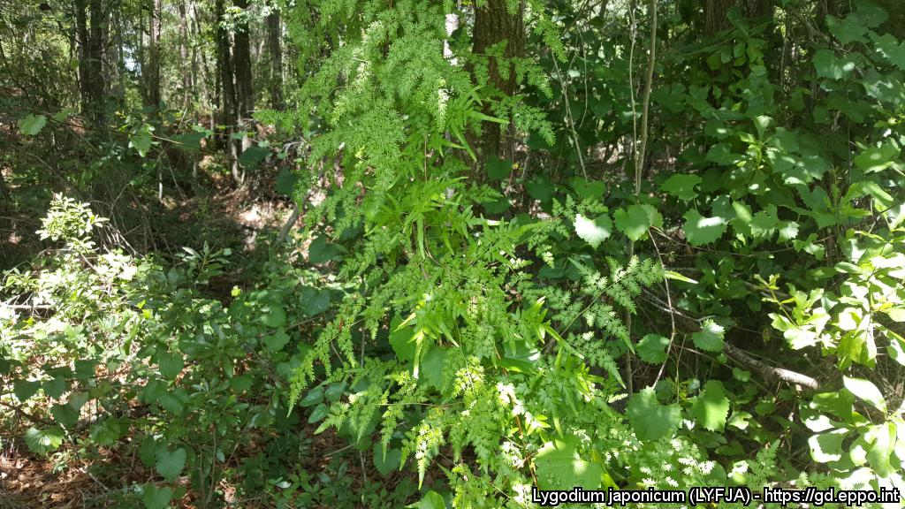
BE AWARE!
Lygodium japonicum
A threat to the EPPO region
How to recognize it? Can you help us?
L. japonicum is a rhizomatous vine, with a twining rachis climbing to 30 m. Below-ground rhizomes are creeping, with black to reddish-brown hairs. Stipes are spaced to 1 cm apart on rhizome. Stems remain underground, but send up long vine-like indeterminate fronds that have numerous compound pinnae. Pinnae on frondlets are triangular to deltoid-shaped, with short stalks, about 3-5 cm long. The mid-ribs (costae) have scattered hairs, and veins and pinnae surfaces are typically glabrous. Each pinnule on the pinnae is pinnate to lobed and stalked often with dissected terminal lobes. Pinnules are pubescent below and margins are variously dentate.
Because Lygodium japonicum has the potential to impact the habitats it invades, including native plant species and important ecosystem services, it is important to report any sightings to plant protection authorities. Early detection will allow a rapid implementation of appropriate measures against Lygodium japonicum.
If you see Lygodium japonicum:
Check the identification of the species with other vine like species.
Whenever possible, take a picture of the plant, record exact location, date and habitat where it was observed.
Contact us.
Contact us
Image: Kimberly Bohn, EPPO Global Database
Your contact details
Your institution name
Logo
Image: Steve Miller, EPPO Global Database
This leaflet has been prepared within the LIFE funded project LIFE15 PRE FR 001 in collaboration with the NERC Centre for Ecology and Hydrology
Prepared in collaboration with EPPO – www.eppo.int

Slide 16
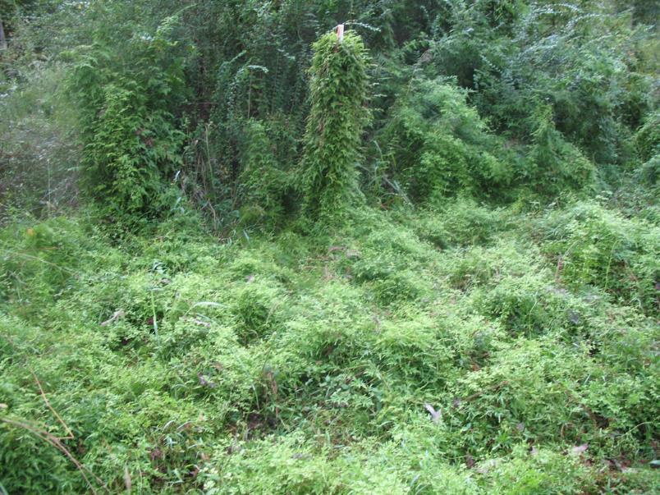
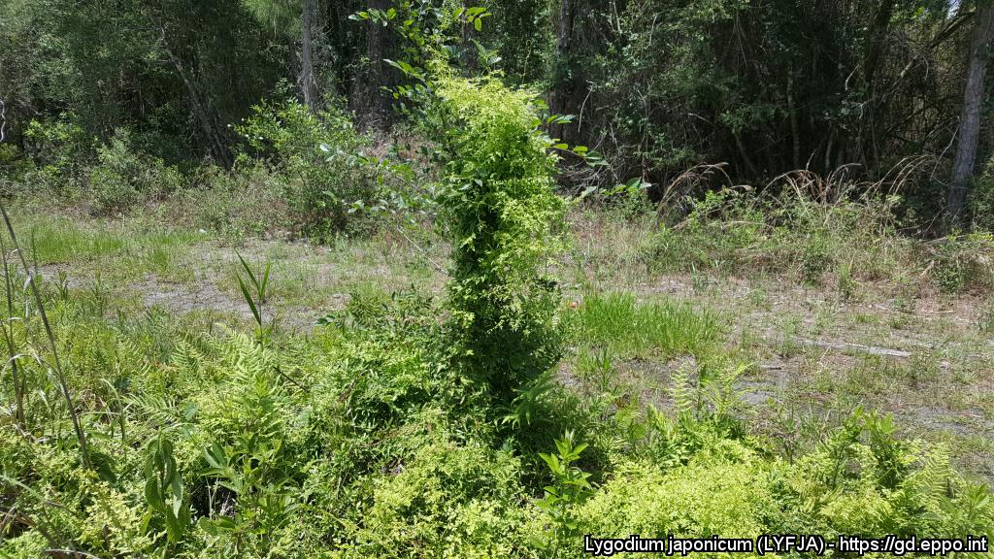
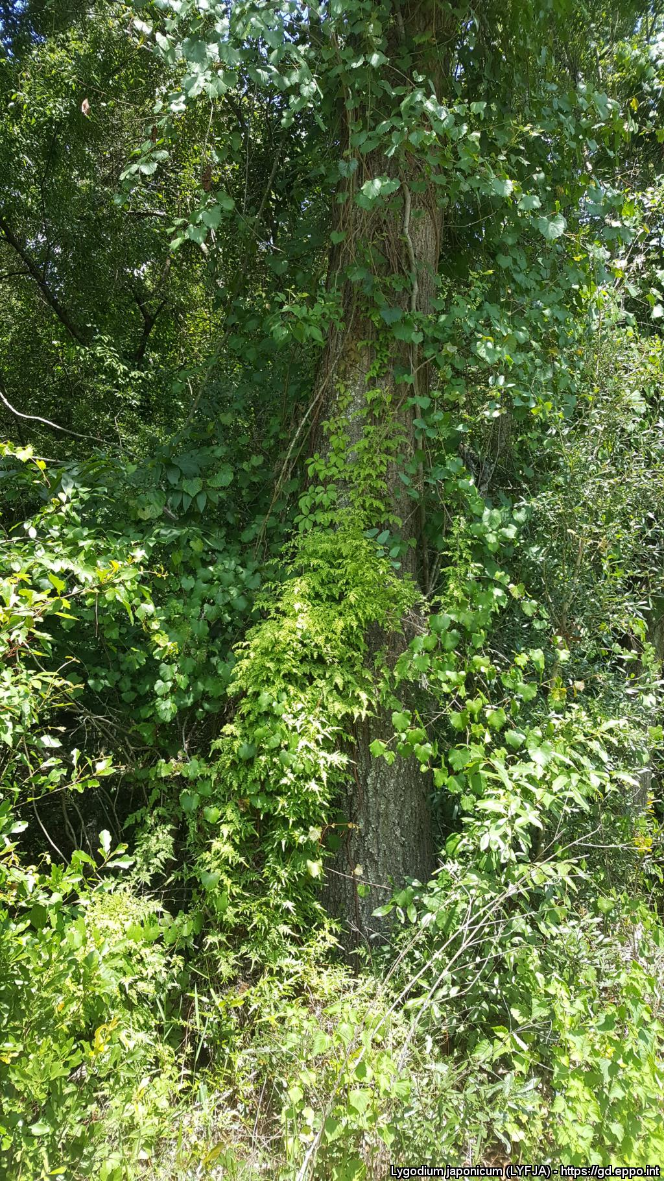
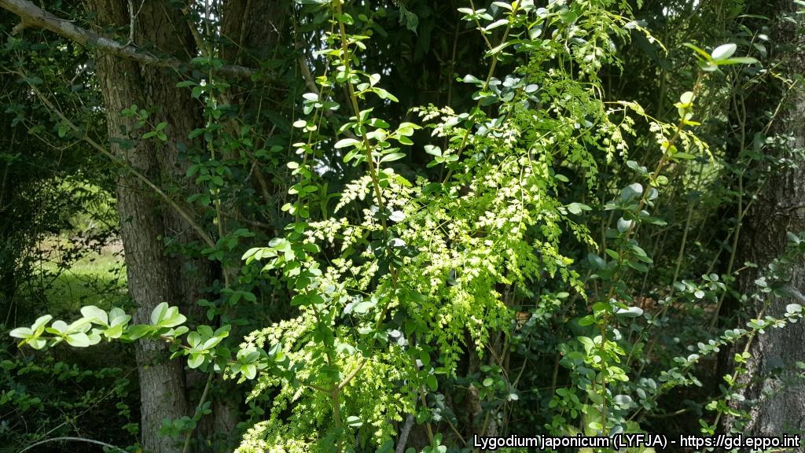
What is L. japonicum? What is the problem? Where is it found?
Lygodium japonicum is a broadleaved, herbaceous perennial climbing fern native to Asia. Lygodium japonicum is a true fern that reproduces by spores (homosporous fern), which then germinate and develop through gametophyte and sporophyte stages.
As Lygodium japonicum is considered to be a threat to native biodiversity, its appearance in new areas should be reported immediately to us.
The pathway plants for planting is considered the main entry pathway into the EPPO region.
In North America, L. japonicum was introduced as an ornamental plant. In the Netherlands gametophytes have been detected in growing media of bonsai plants imported from China. L. japonicum can grow in sun or shade, damp, disturbed or undisturbed areas in the US. It can grow so dense that it forms a living ‘wall’, leading to the elimination of seedlings and other native vegetation.
The species has been shown to reduce native plant species richness and diversity.
The species is currently absent from the natural environment in the EPPO region.
In its invasive range, in particular in North America, it invades a diverse range of habitats including habitats floodplain forests, swamps, marshes, river and stream banks and upland woodlands.
Image: Kimberly Bohn, EPPO Global Database
Above-ground foliage of L. japonicum dies back after frost and temperatures at or near 0° C however belowground root and rhizomes will remain dormant through winter and resprout when temperatures reach at least 18 °C.
In North Florida, spore development begins around late June to July, become mature in late August, and disperse throughout mid-September through late October.
Image: Steve Miller, EPPO Global Database
Image: Steve Miller, EPPO Global Database

Slide 17
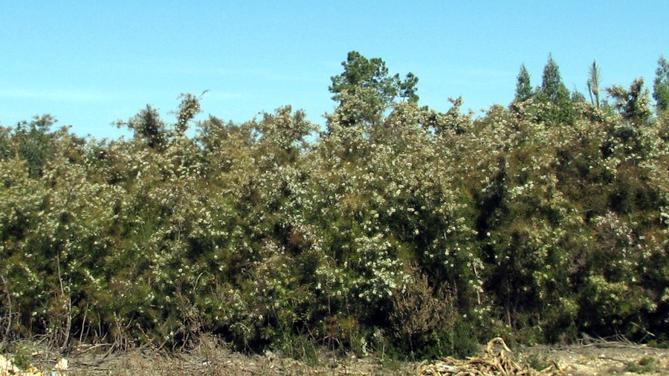
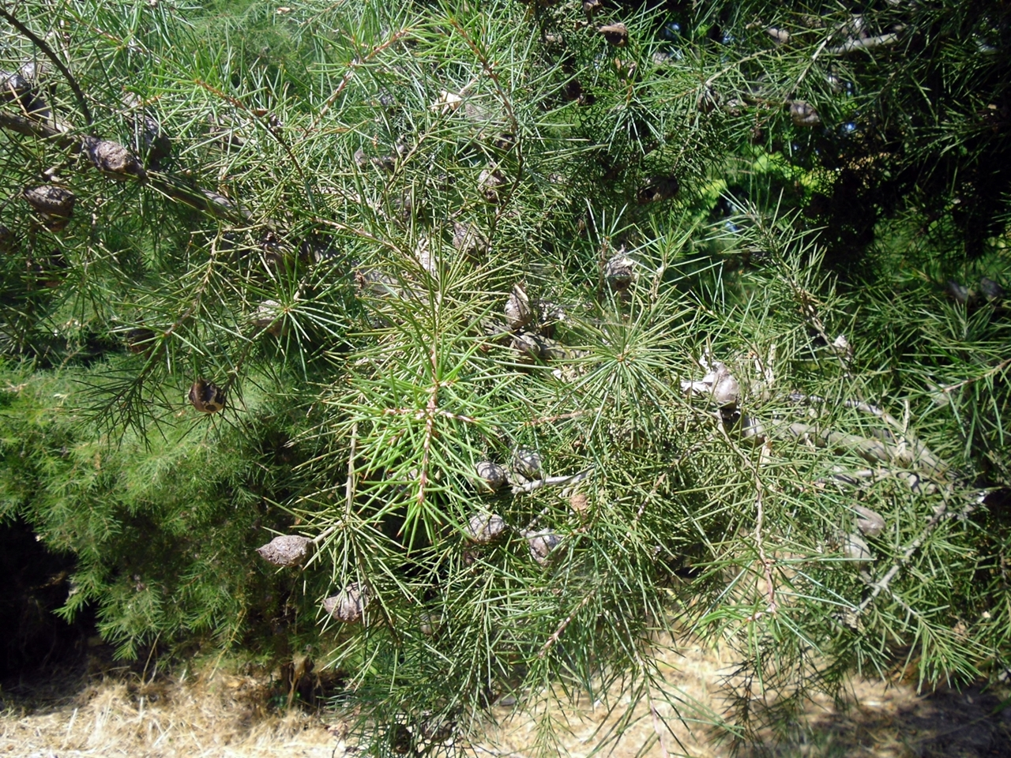
BE AWARE!
Hakea sericea
A threat to the EPPO region
How to recognize it? Can you help us?
Hakea sericea is an erect, single-stemmed, woody shrub or small tree, 0.6-4.5 m in height, with somewhat angular stems. It has simple, needle-like leaves, which are terete (i.e. circular in cross section), spiny, and moderately appressed silky-hairy when young, but quickly becoming glabrous; these leaves are (1.3)2-4.3-(5.3) cm long and 0.7-1(1.1) mm wide, with a longitudinal groove on the lower side. The inflorescence is an axillary umbel, consisting of (1)4-5(6) cream-coloured flowers, each with a moderately to densely white-hairy pedicel (2.2-5.0 mm long). One to two woody follicles or fruits, sometimes also referred to as capsules, are formed in each axil; the fruits are (2)2.5-3(4) cm long and 2-2.5 cm in diameter.
Because Hakea sericea has the potential to impact the habitats it invades, including native plant species and important ecosystem services, it is important to report any sightings to plant protection authorities. Early detection will allow a rapid implementation of appropriate measures against Hakea sericea.
If you see Hakea sericea:
Check the identification of the species with other shrub like species.
Whenever possible, take a picture of the plant, record exact location, date and habitat where it was observed.
Contact us.
Contact us
Image: Elizabete Marchante, EPPO Global Database
Your contact details
Your institution name
Logo
Image: Elizabete Marchante, EPPO Global Database
This leaflet has been prepared within the LIFE funded project LIFE15 PRE FR 001 in collaboration with the NERC Centre for Ecology and Hydrology
Prepared in collaboration with EPPO – www.eppo.int

Slide 18
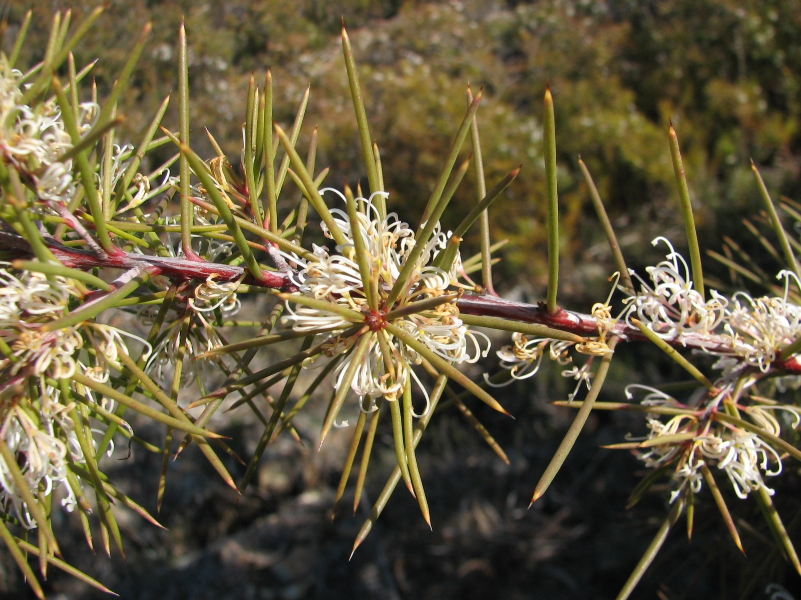
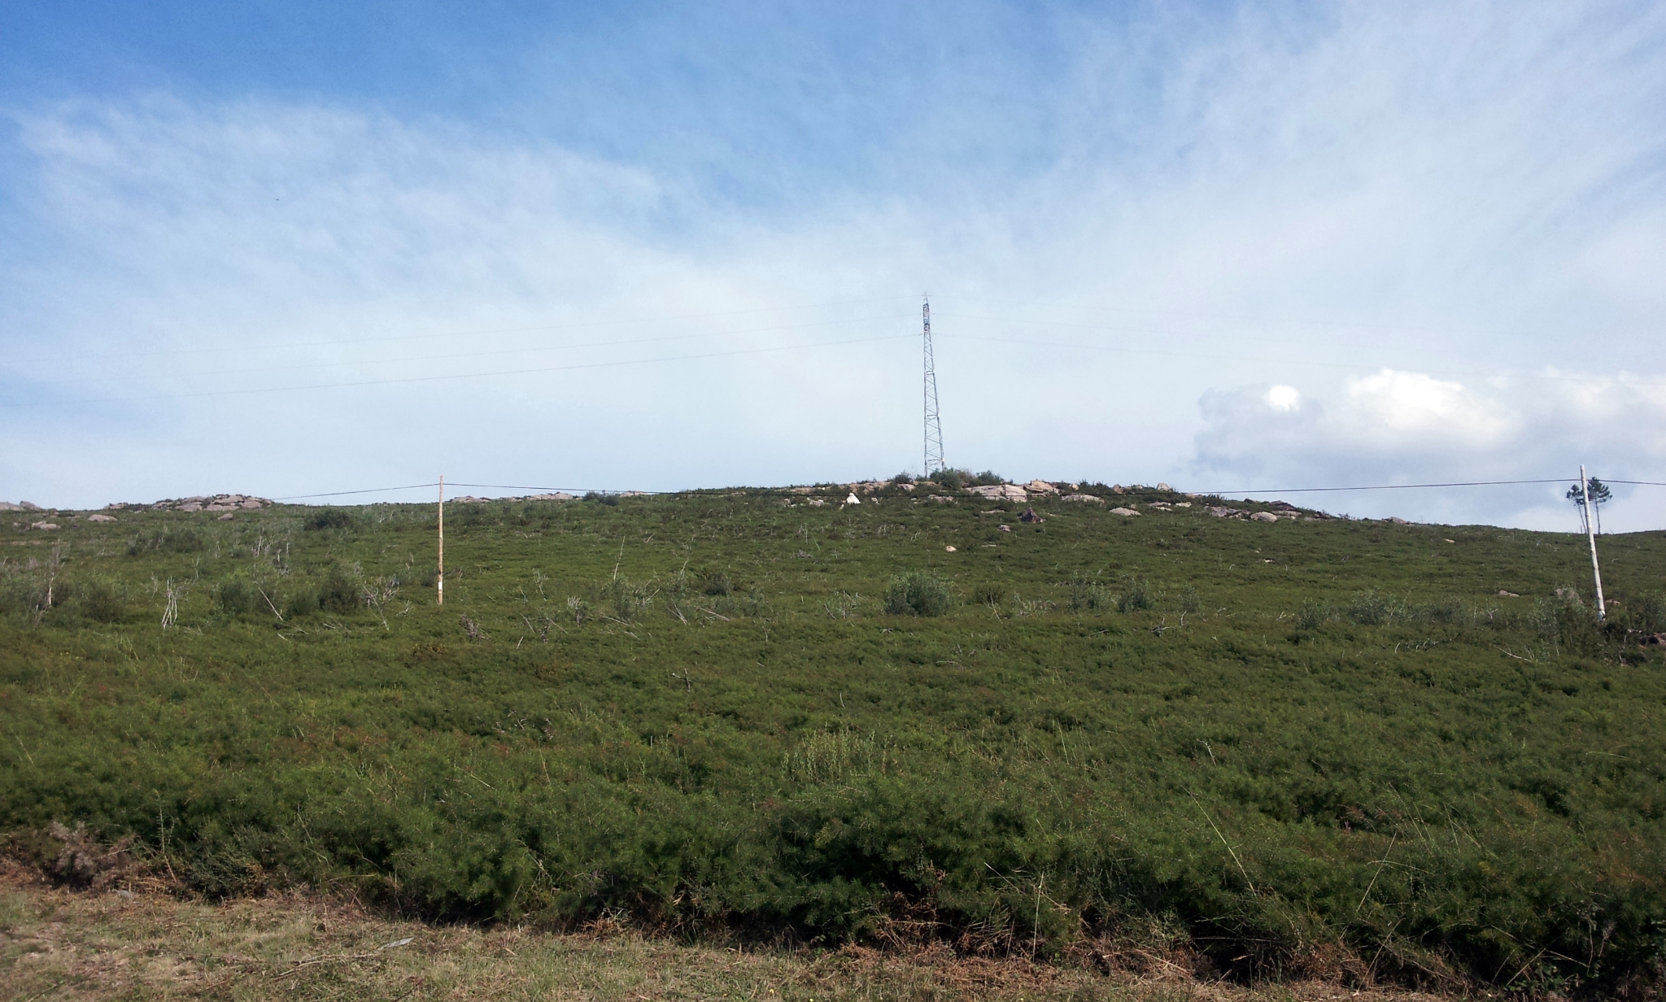
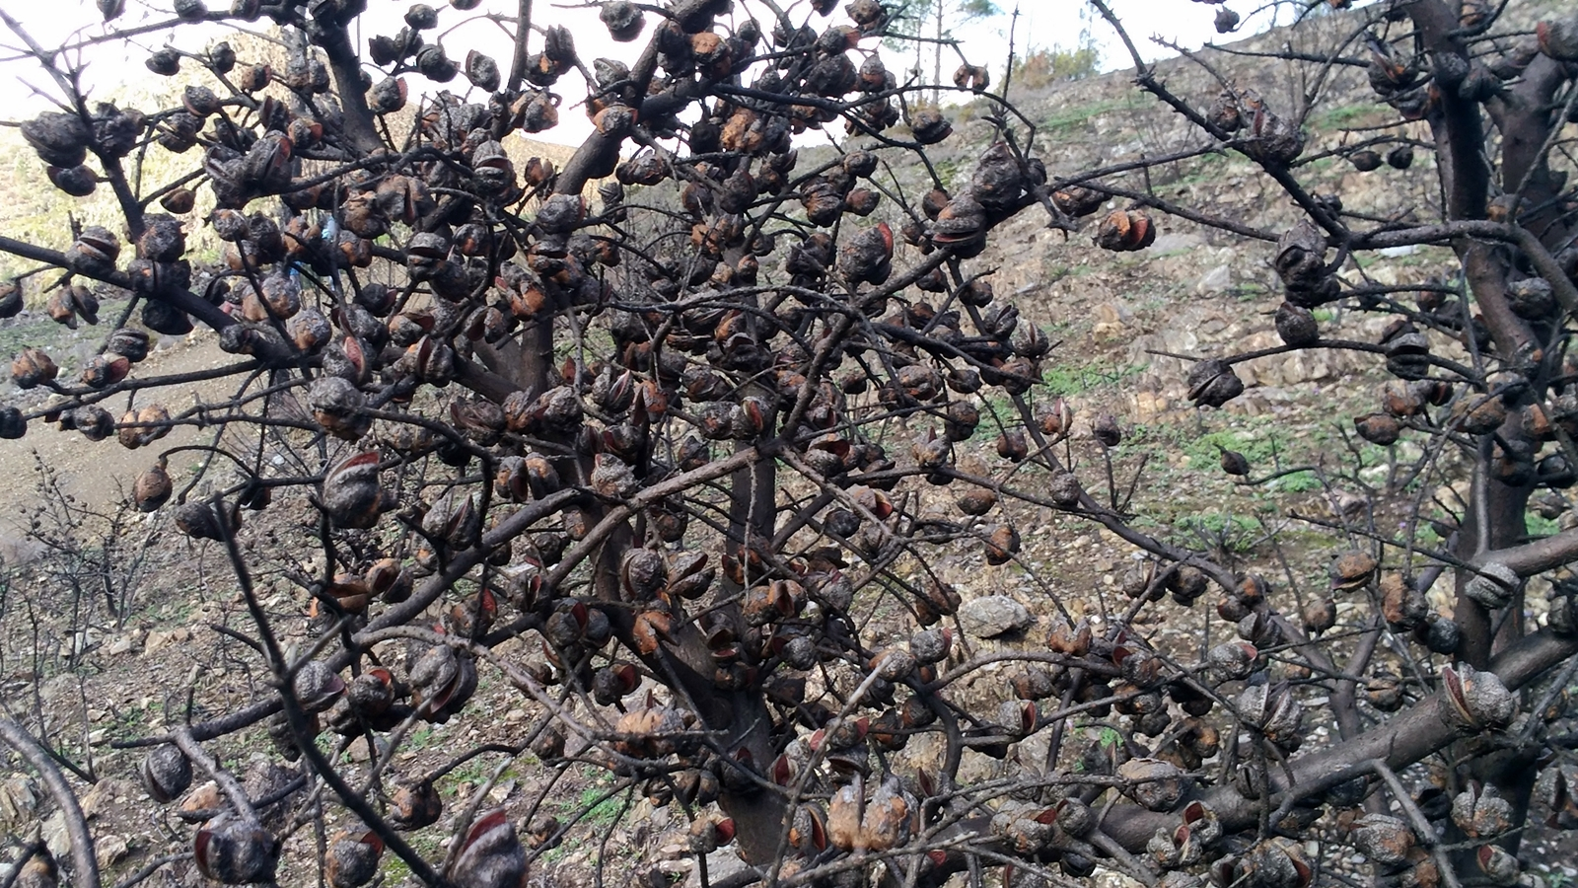
What is Hakea sericea? What is the problem? Where is it found?
In Portugal, H. sericea forms extensive dense monospecific stands which can exclude native plant species and/or change community composition, including associated fauna. Areas highly susceptible to invasion by H. sericea in the north of Portugal, are coincident with the distribution area of Succisa pinnatifida Lange, a rare endemic of the Iberian Peninsula. The high spread potential of the species acts to threaten and reduce the biodiversity of the Esterel Mountains in France, by eliminating less competitive native species of maquis and forest.
Thickets of H. sericea increase fire hazard, particularly fire intensity. Dense thickets of the plant are likely to restrict access for livestock, grazing, hunting and recreation in Mediterranean regions, thus having potential economic impact.
In the EPPO region, H. sericea is recorded from France, Madeira, Portugal and Spain.
In the EPPO region, disturbed areas (particularly road margins), forest margins, coastal grasslands and pine forest are all highlighted as additional habitats. Plants for planting has been the main pathway for entry into the EPPO region. The plant is known to be used as an ornamental and hedging species, and therefore could be imported as seeds or plants for this purpose.
Image: Elizabete Marchante, EPPO Global Database
Hakea sericea (EPPO List of invasive alien plants) is an evergreen shrub or small tree native to Australia.
As Hakea sericea is considered to be a threat to native biodiversity, its appearance in new areas should be reported immediately to us.
Image: Elizabete Marchante, EPPO Global Database
Fire is a key part of the life cycle of H. sericea, with the heat-resistant fruits accumulating on a plant throughout its lifetime. The plant itself is absolutely fire sensitive. However, after plant death, typically through fire, the fruits release their seeds.
Image: Elizabete Marchante, EPPO Global Database
Image: Elizabete Marchante, EPPO Global Database

Slide 19
BE AWARE!
Humulus scandens
A threat to the EPPO region
How to recognize it? Can you help us?
Leaves are opposite, blades are light green, cordate, palmately lobed with 5-7(-9) lobes, 5-12 cm long with petioles longer than the blade. Inflorescences the male inflorescences form an erected branched panicle, 15-25 cm, flower anthers without glands, female inflorescences are ovoid cone-like spikes; bracteole ovate-orbiculate, 7-10 mm, pilose, margins densely ciliate-hairy.
Three 7-lobed leaves of H. scandens (below) compared to 1-4 lobed leaves of H. lupulus (above). See the petiole longer than the leaf for H. scandens and the lighter green colour of the leaves.
Because Humulus scandens has the potential to impact the habitats it invaded, including native plant species and important ecosystem services, it is important to report any sightings to plant protection authorities. Early detection will allow a rapid implementation of appropriate measures against Humulus scandens.
If you see Humulus scandens:
Check the identification of the species with other vine like species.
Whenever possible, take a picture of the plant, record exact location, date and habitat where it was observed.
Contact us.
Contact us
Your contact details
Your institution name
Logo
All images © Guillaume FRIED (Anses) © Guillaume FRIED (Anses)
This leaflet has been prepared within the LIFE funded project LIFE15 PRE FR 001 in collaboration with the NERC Centre for Ecology and Hydrology
Prepared in collaboration with EPPO – www.eppo.int

Slide 20
What is H. scandens? What is the problem? Where is it found?
The pathway plants for planting is considered the main entry pathway into the EPPO region. H. scandens has been introduced in Europe as an ornamental species for growing over trellises, arbours or fences. It can outcompete native species and is considered as a transformer species, that threatens plant communities. Dense mats of the species can persist along riverbanks for several years. Ecosystem functioning (for example, reduced species richness and decrease functional richness) is altered when the species invade riparian habitats.
The species is recorded in the EPPO region from Austria, Belgium, Czech Republic, France, Germany, Italy, Hungary, Romania, Serbia, Slovakia, Slovenia, Switzerland, Ukraine.
In both its native range and its introduced range, H. scandens is a plant of riverside, particularly on the loose, bare surfaces of alluvial bars formed by river and stream-sides by temporary floods. The plant can also invade ruderal areas under climates with no dry seasons.
Humulus scandens is a herbaceous annual vine native to Asia.
As Humulus scandens is considered to be a threat to native biodiversity, its appearance in new areas should be reported immediately to us.

Slide 21
BE AWARE!
Ehrharta calycina
A threat to the EPPO region
How to recognize it? Can you help us?
A very variable species that has many described ecotypes or regional variants suggesting that it represents a species complex. It is a tussock grass, with culms generally varying in height from 300 to 70 cm high (but can reach up to 180 cm) and has creeping, branched rhizomes. Leaves are often red to purple tinged, up to 7 mm in width, flat or rolled, often wrinkled along the blade margin and filiform in shape. Inflorescences (panicles) are red in colour and may be produced at any time of the year, but usually in spring.
Because Ehrharta calycina has the potential to impact the habitats it invaded, including native plant species and important ecosystem services, it is important to report any sightings to plant protection authorities. Early detection will allow a rapid implementation of appropriate measures against Ehrharta calycina.
If you see Ehrharta calycina:
Check the identification of the species with other grass species.
Whenever possible, take a picture of the plant, record exact location, date and habitat where it was observed.
Contact us.
Image: Sian Mawson, Friends of Queens Park Bushland
Contact us
Your contact details
Your institution name
Logo
Image: Sian Mawson, Friends of Queens Park Bushland
This leaflet has been prepared within the LIFE funded project LIFE15 PRE FR 001 in collaboration with the NERC Centre for Ecology and Hydrology
Prepared in collaboration with EPPO – www.eppo.int

Slide 22
What is E. calycina? What is the problem? Where is it found?
Ehrharta calycina is a perennial grass species native to South Africa.
This species can form monospecific stands by suppressing the germination of native species through rapid growth and shading out of native plant seedlings. E. calycina can initiate an enhanced grass-fire cycle, promoting more frequent fires, which in turn favour this fire-adapted species at the expense of native plant species
As Ehrharta calycina is considered to be a threat to native biodiversity, its appearance in new areas should be reported immediately to us.
There is no evidence that the species is currently promoted as a forage grass within the EPPO region but this is how it entered Tunisia where it was introduced as a fodder and pasture grass, almost certainly as seed. In California and Australia, E. calycina can dominate plant communities, excluding native plant species and transforming shrubland into grasslands. E. calycina either prevents the germination of native plants or prevents their establishment and survival through promotion of more frequent fires.
In the EPPO region, the species is recorded from Portugal, Spain and Tunisia.
In Spain, it has been found in dunes and dry pastures, in Portugal along roadsides and open woodland, and in Tunisia in pastures.
Joseph M. DiTomaso, University of California - Davis, Bugwood.org
Image: Sian Mawson, Friends of Queens Park Bushland
Joseph M. DiTomaso, University of California - Davis, Bugwood.org

Slide 23
BE AWARE!
Andropogon virginicus
A threat to the EPPO region
How to recognize it? Can you help us?
Andropogon virginicus is an herbaceous, perennial, warm season (C₄) grass. It has a cespitose (i.e. densely tufted) growth form, and a height range of 40-210 cm. The culms are typically branched distally, with light-green to reddish brown colouration. The leaf-sheaths are long-ciliate, with a tuberculate (scabrous) surface. The ligules are yellow to brownish and membranous, 0.2-1 mm, with cilia 0.2-1.3 mm. Leaf blades reach up to 52 cm, and are 1.7-6.5 mm wide. These blades are variably hairy.
The species is very difficult to tell apart from close relatives.
Because Andropogon virginicus has the potential to impact the habitats it invades, including native plant species and important ecosystem services, it is important to report any sightings to plant protection authorities. Early detection will allow a rapid implementation of appropriate measures against Andropogon virginicus.
If you see Andropogon virginicus:
Check the identification of the species with other grass like species.
Whenever possible, take a picture of the plant, record exact location, date and habitat where it was observed.
Contact us.
Image: John D. Byrd, Mississippi State University, Bugwood.org
Contact us
Your contact details
Your institution name
Logo
Image: John D. Byrd, Mississippi State University, Bugwood.org
This leaflet has been prepared within the LIFE funded project LIFE15 PRE FR 001 in collaboration with the NERC Centre for Ecology and Hydrology
Prepared in collaboration with EPPO – www.eppo.int

Slide 24
What is A. virginicus? What is the problem? Where is it found?
Andropogon virginicus (EPPO Observation List of invasive alien plants) is an erect perennial grass which is native to South and Central America.
As Andropogon virginicus is considered to be a threat to native biodiversity, its appearance in new areas should be reported immediately to us.
Andropogon virginicus stands can be dense, widespread, and highly competitive suggesting the species reduces biodiversity. The species is reported to be able to dominate within the grass layer. Although present in the EPPO region, there are no reported studies that have evaluated the ecological or economic impact of A. virginicus in the region. However, due to its aggressive spread in natural areas in Georgia, and around the Black Sea, and due to the rapid expanse of the plant in France, potential impacts are likely to be high.
There is evidence that A. virginicus has entered the EPPO region as a contaminant of machinery and equipment. In France, it is suspected that A. virginicus was introduced into the military camp with munitions in the years 1950-1967.
The species is present in the EPPO region, recorded from France, the Russian Federation and Georgia.
A. virginicus invades a wide variety of habitats from disturbed to relatively intact habitats including ruderal areas, wetlands, open pastures, grasslands, and open woodlands.
The species is invasive also in Asia, North America, Australia and new Zealand.
Image: John D. Byrd, Mississippi State University, Bugwood.org
Image: John Ruter, University of Georgia, Bugwood.org
Image: John D. Byrd, Mississippi State University, Bugwood.org

Slide 25
BE AWARE!
Lespedeza cuneata
A threat to the EPPO region
How to recognize it? Can you help us?
Lespedeza cuneata is a long-lived perennial or subshrub, growing to a height of 0.5-1 m. The plant produces trifoliate leaves along the entire stem. Stems can be coarse or fine, depending on the cultivar. Leaflets are long, narrow, and indented at the end; one of the key features that has been used to distinguish L. cuneata from L. juncea.
Because Lespedeza cuneata has the potential to impact the habitats it invades, including native plant species and important ecosystem services, it is important to report any sightings to plant protection authorities. Early detection will allow a rapid implementation of appropriate measures against Lespedeza cuneata.
If you see Lespedeza cuneata:
Check the identification of the species with other legume like species.
Whenever possible, take a picture of the plant, record exact location, date and habitat where it was observed.
Contact us.
Image: Chris Evans, University of Illinois, Bugwood.org
Contact us
Your contact details
Your institution name
Logo
Image: Chris Evans, University of Illinois, Bugwood.org
This leaflet has been prepared within the LIFE funded project LIFE15 PRE FR 001 in collaboration with the NERC Centre for Ecology and Hydrology
Prepared in collaboration with EPPO – www.eppo.int

Slide 26
What is L. cuneata? What is the problem? Where is it found?
Lespedeza cuneata is an erect or sub-erect perennial herbaceous legume native to Asia.
As Lespedeza cuneata is considered to be a threat to native biodiversity, its appearance in new areas should be reported immediately to us.
Lespedeza cuneata can thrive under a variety of conditions, crowding out native species in natural areas. The species forms dense stands in areas where it invades, reducing light availability and potentially increasing competition for soil water. Invasions into oak savannas in southeastern Kansas (US) have reduced native plant species richness and reduced the abundance of invertebrate species. L. cuneata may also have impacts on native plant communities through allelopathic effects. Allelopathic chemicals have been found to reduce native grass species’ performance by up to 60%.
The species is currently absent from the natural environment in the EPPO region.
Throughout its invasive range, the species invades habitats such as grassland, woodland, forests, edges of wetlands, pastures, and disturbed sites. The species may be grown on a small scale and available from horticultural suppliers in the EPPO region. The species is also utilised as a forage species outside of the EPPO region and could be imported into the region for this purpose in the search for new protein plants in the future.
Image: Chris Evans, University of Illinois, Bugwood.org
Image: Chuck Bargeron, University of Georgia, Bugwood.org
Image: Dan Tenaglia, Missouriplants.com, Bugwood.org

Slide 27
BE AWARE!
Triadica sebifera
A threat to the EPPO region
How to recognize it? Can you help us?
A deciduous tree 20 to 30 meters tall. Low-spreading and multi-forked to tall and columnar. Stem often crooked and gnarled. Bark is grey, brown, and rough. Exudes a milky sap. Twigs slender. Petioles 2-6 cm long, with 2 sessile disc-shaped glands at the apex. Leaf-blades broadly rhombic-ovate, 2-7.5 x 1.5-7 cm, abruptly acutely acuminate, broadly cuneate to rounded, subtruncate at the base, entire, lateral nerves 7-12 pairs, glaucous beneath. Stipules 1-2 mm long, obtuse. T. sebifera flowers from April to June, producing both male and female flowers. Fruits are 1 cm three-lobed capsules expected to mature in the autumn.
Because Triadica sebifera has the potential to impact the habitats it invades, including native plant species and important ecosystem services, it is important to report any sightings to plant protection authorities. Early detection will allow a rapid implementation of appropriate measures against Triadica sebifera.
If you see Triadica sebifera:
Check the identification of the species with other tree species.
Whenever possible, take a picture of the plant, record exact location, date and habitat where it was observed.
Contact us.
Image: Chris Evans, University of Illinois, Bugwood.org
Contact us
Your contact details
Your institution name
Logo
Image: Cheryl McCormick, University of Florida, Bugwood.org
This leaflet has been prepared within the LIFE funded project LIFE15 PRE FR 001 in collaboration with the NERC Centre for Ecology and Hydrology
Prepared in collaboration with EPPO – www.eppo.int

Slide 28
What is T. sebifera? What is the problem? Where is it found?
Triadica sebifera is a deciduous medium sized tree species which is native to Asia.
As Triadica sebifera is considered to be a threat to native biodiversity, its appearance in the natural environment should be reported immediately to us.
T. sebifera has a long history of deliberate planting within the EPPO region. Seeds can be bought on the internet and shipped nearly anywhere in the EPPO region.
In the USA, T. sebifera displaces native plant species and establishes dominant stands and can transform areas of prairie and grassland to woody thickets within ten years. T. sebifera can decrease water quality. The species can also displace native species reducing genetic resources. When leaf material becomes incorporated into the water body, this has shown to be toxic to amphibians.
The species is a major invasive species in the Southern States in the US, and presently, the species is absent from the natural environment in the EPPO region.
In North America, T. sebifera has a wide environmental tolerance and can thrive in many different habitats including forests, wetlands, grasslands, coastal prairie, mesic sites, disturbed sites, low-lying fields, swamp, and scrubby flatlands.
Image: Chris Evans, University of Illinois, Bugwood.org
Image: David J. Moorhead, University of Georgia, Bugwood.org
Image: Chris Evans, University of Illinois, Bugwood.org

